Slide 1
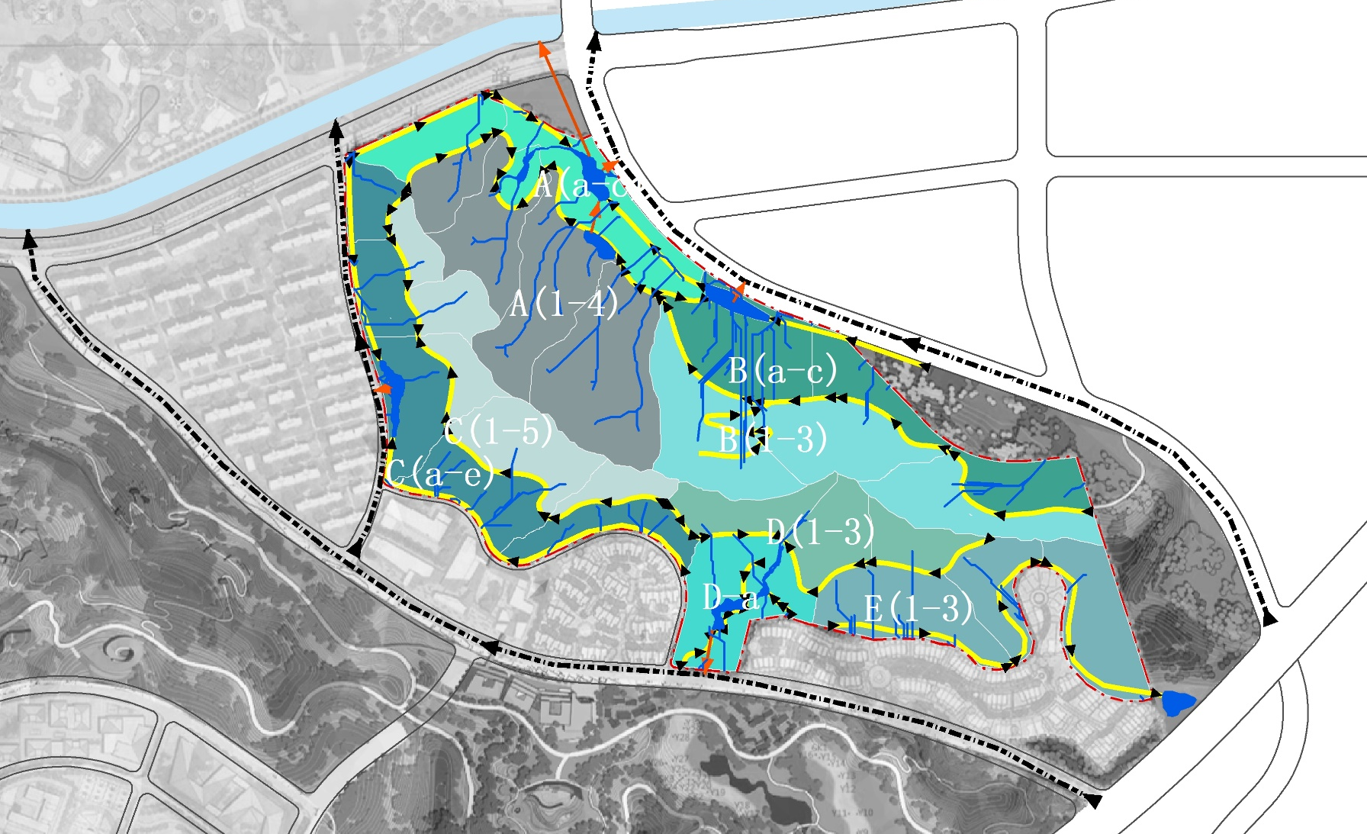

Slide 2
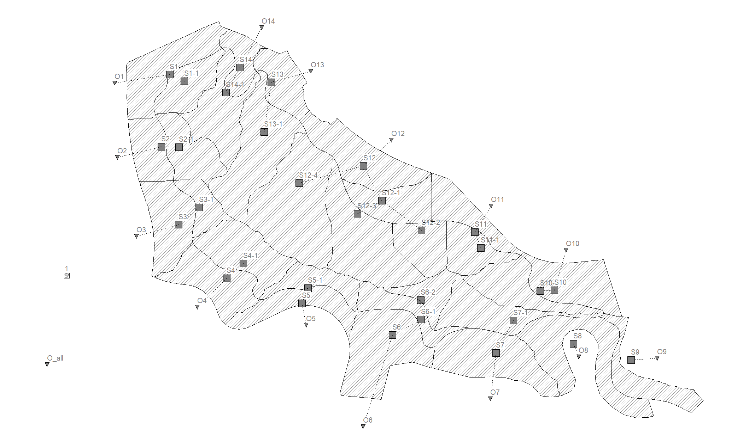

Slide 3
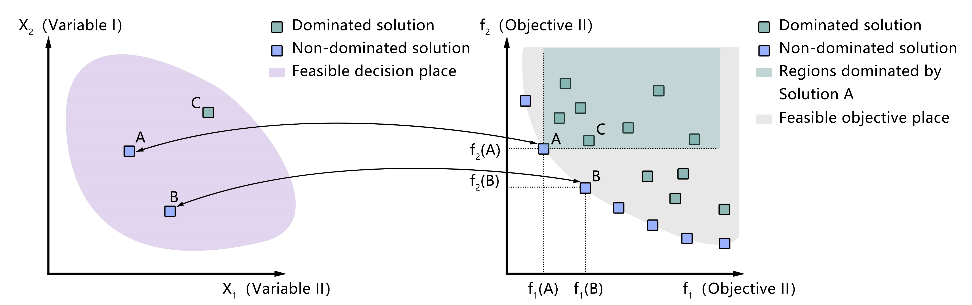

Slide 4
Scenario 01

Slide 5
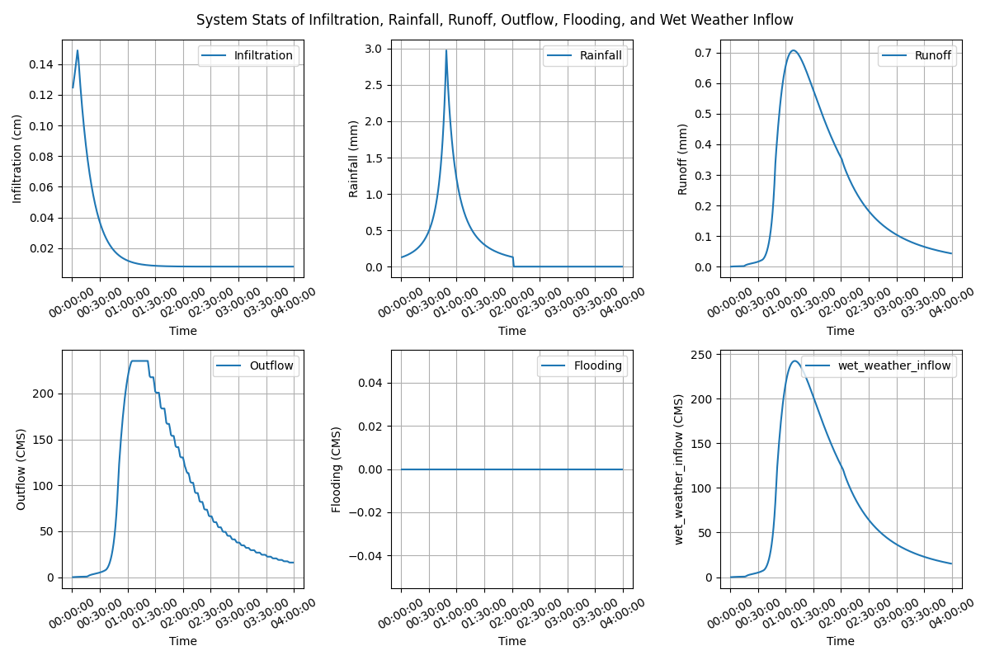
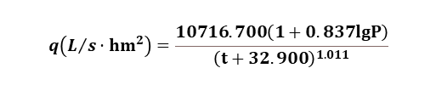
Lijia Mountain Park, Nanjing, China
Subcatchments: 30
Area: 33.73ha
Rainfall- Chicago design storm IDF
Return period: 5 year (2 hour)
Total volume: 75.59mm
IDF formula:
$$q\left(L/s·{hm}^{2}\right)=\frac{10716.700\left(1+0.837lgP\right)}{{\left(t+32.900\right)}^{1.011}}$$

Slide 6
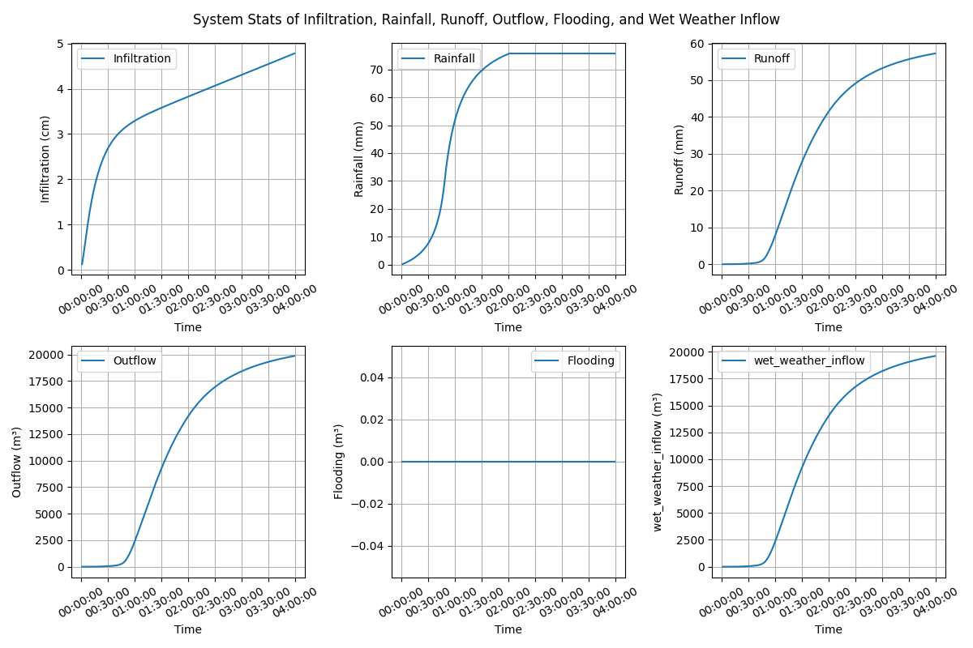
Lijia Mountain Park, Nanjing, China
Subcatchments: 30
Area: 33.73ha
Rainfall- Chicago design storm IDF
Return period: 5 year (2 hour)
Total volume: 75.59mm

Slide 7
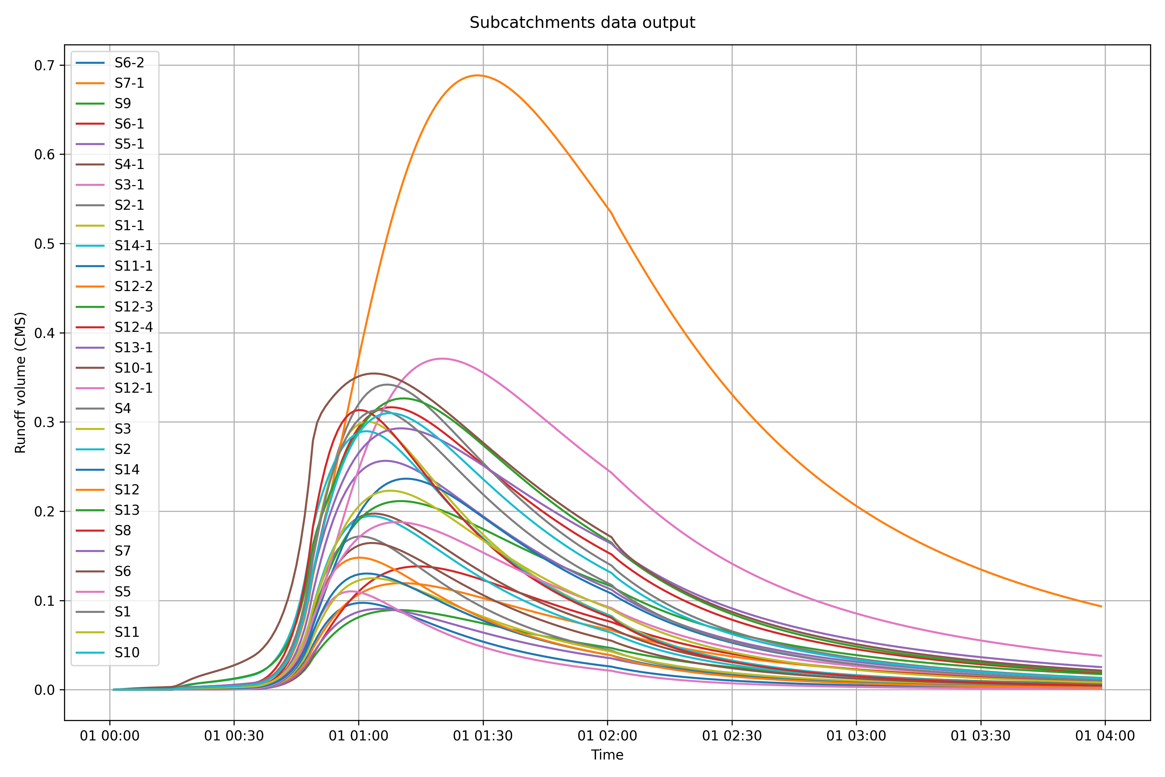
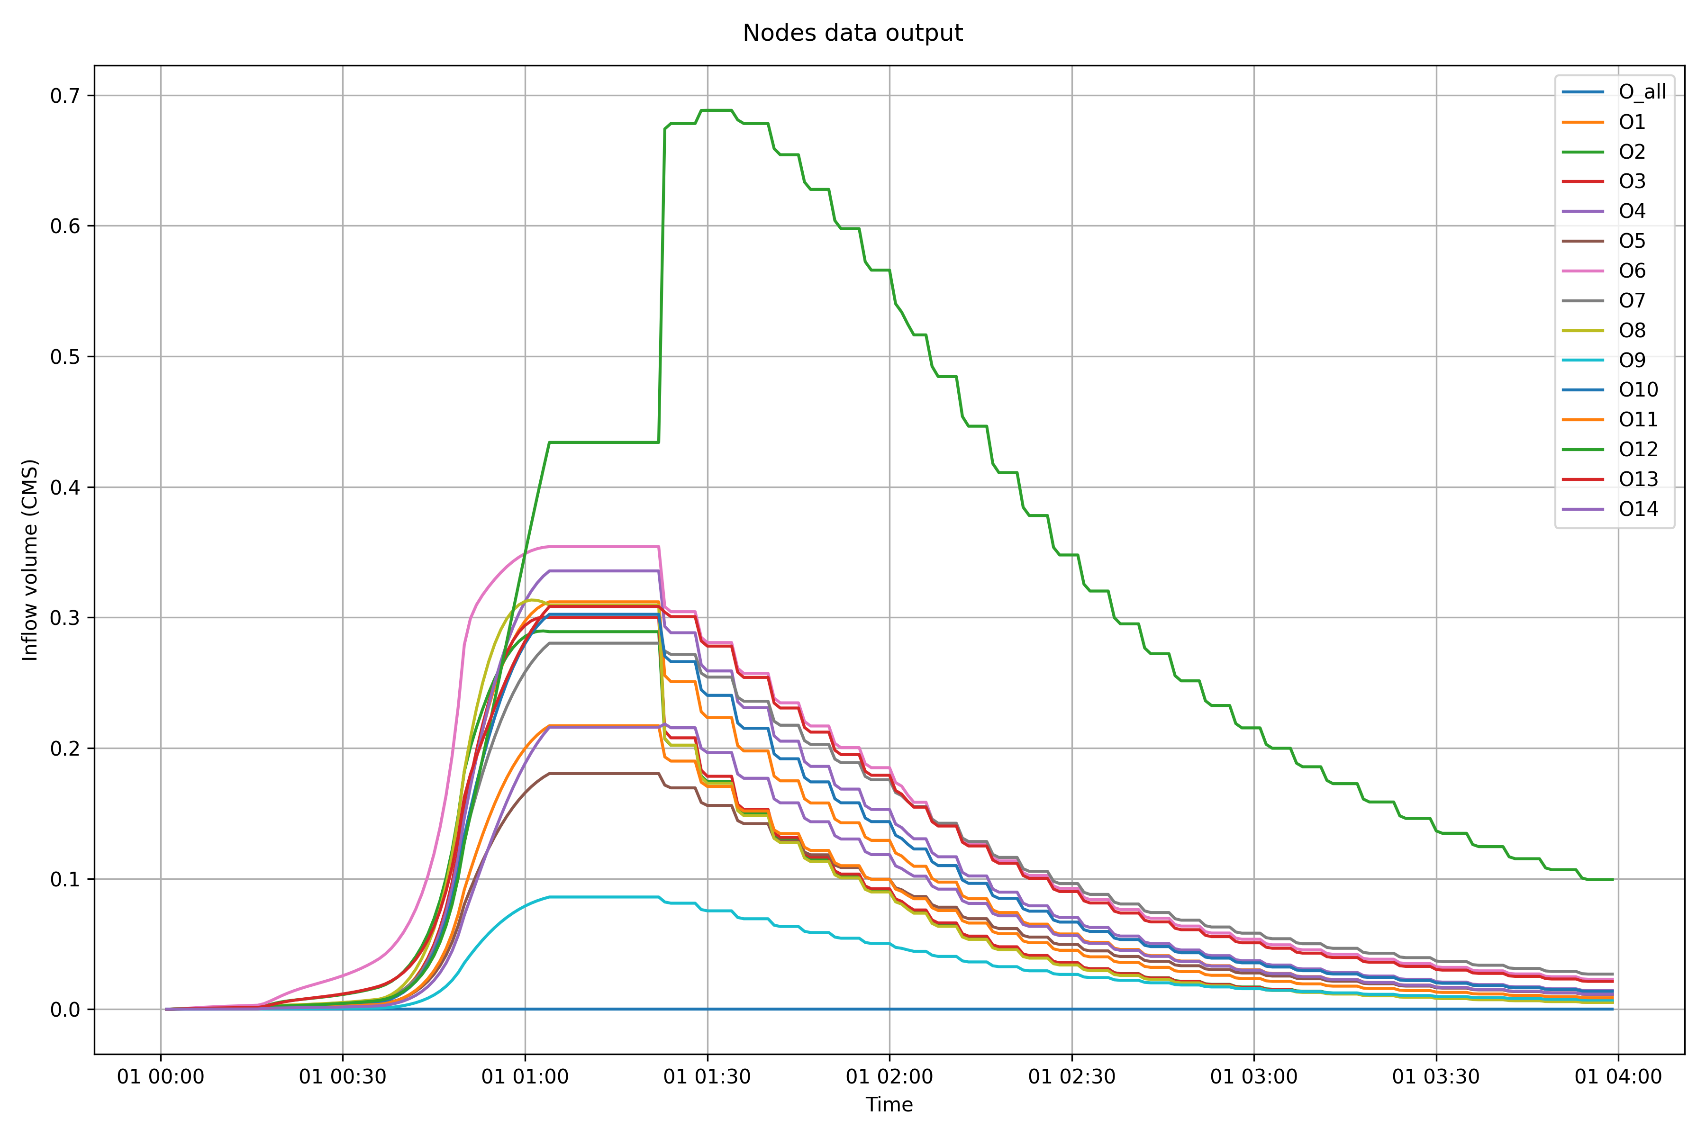

Slide 8
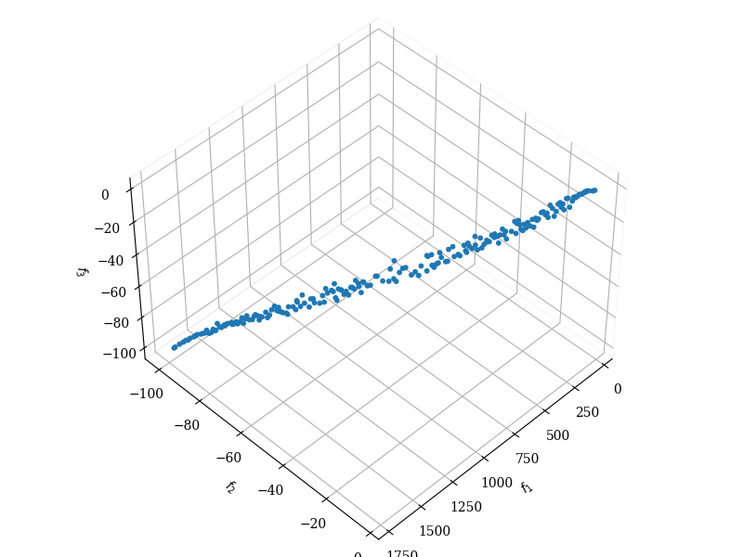
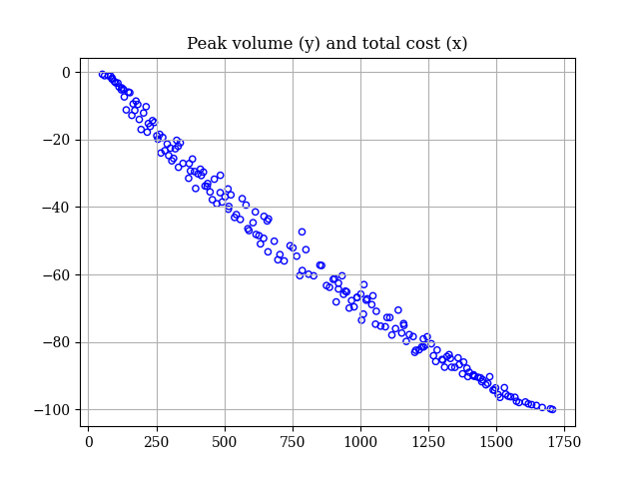
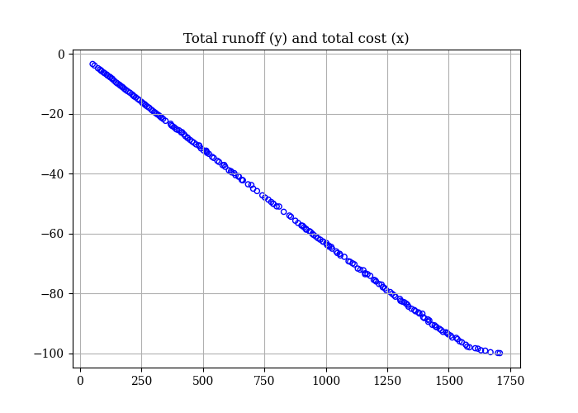
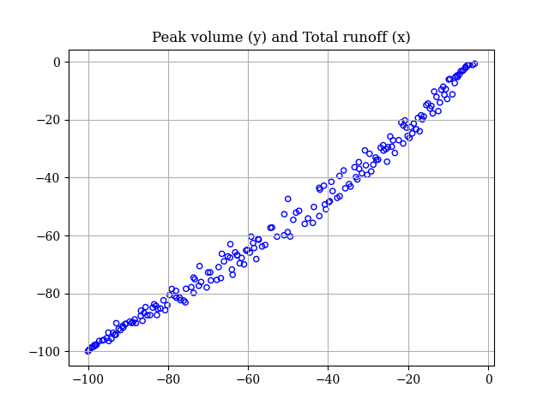
Solution: 17
Balance solution
Cost: 852.0068(10k RMB）
TR reduction: 54.01%
PR reduction 57.23%
BRCs area: 21300.17m²

Slide 9

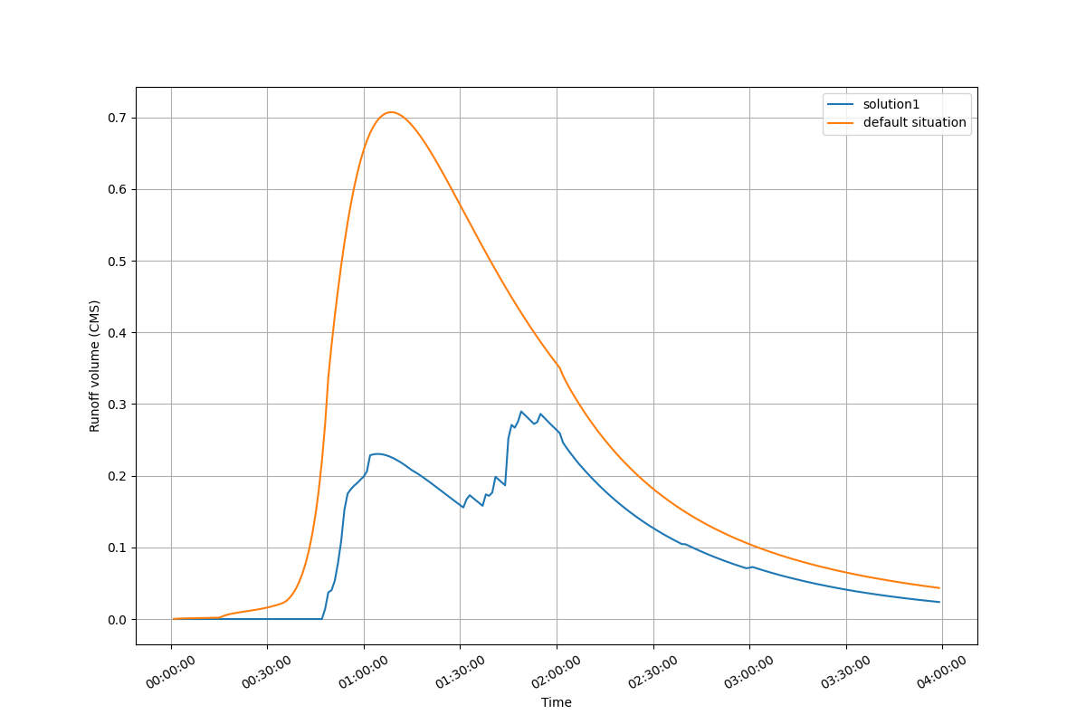
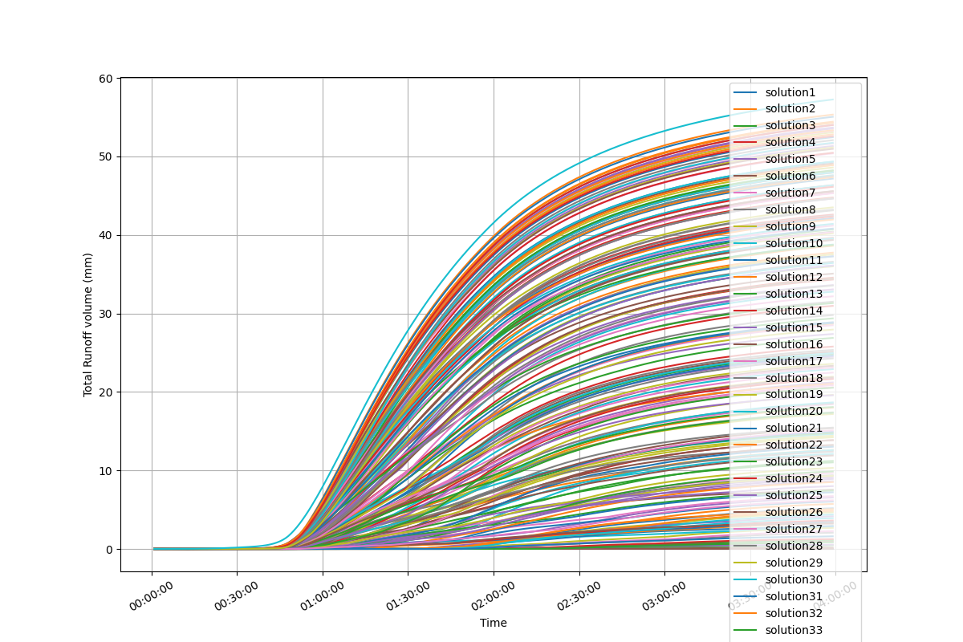
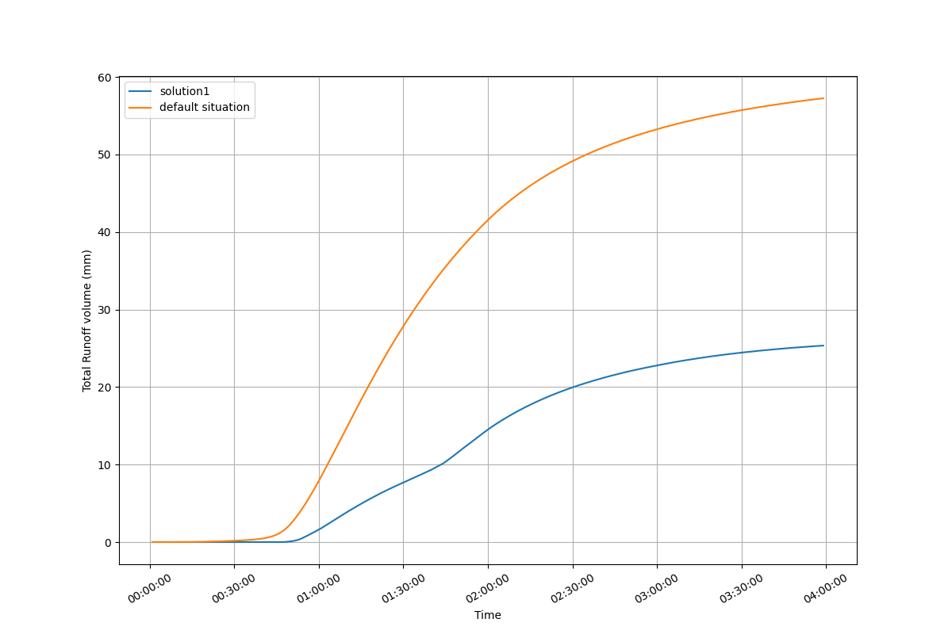
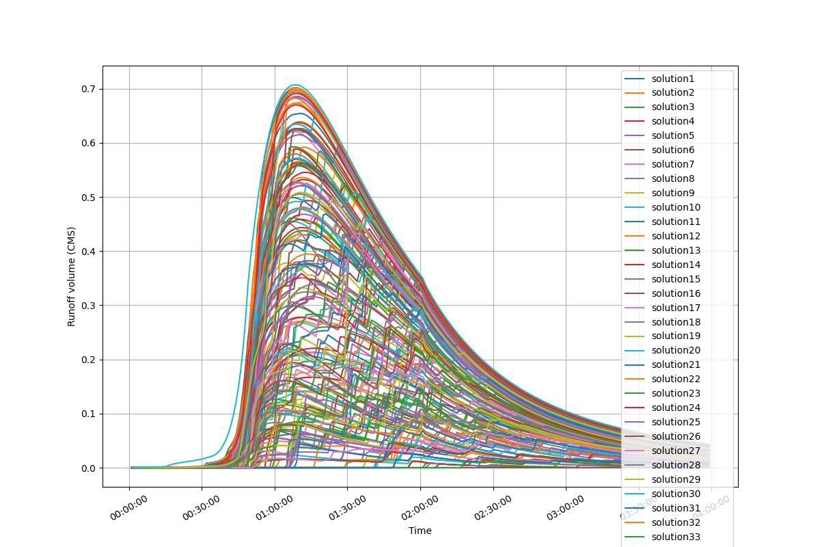
Solution: 17
Balance solution
Cost: 852.0068(10k RMB）
TR reduction: 54.01%
PR reduction 57.23%
BRCs area: 21300.17m²
Variable = [51, 1, 29, 24, 35, 95, 592, 1, 286, 2, 748, 87, 33, 464, 16, 395, 210, 48, 110, 68, 190, 803, 169, 10, 154, 54, 583, 0, 8, 60]

Slide 10
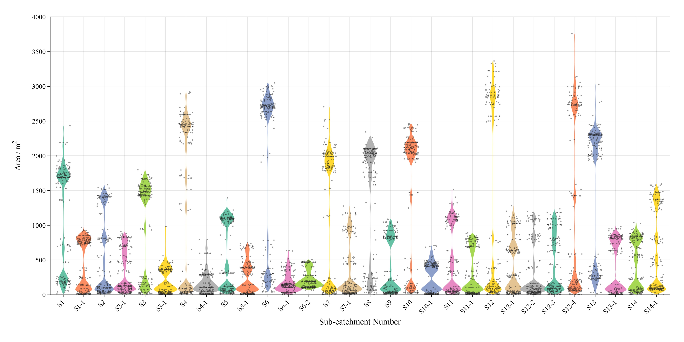

Slide 11
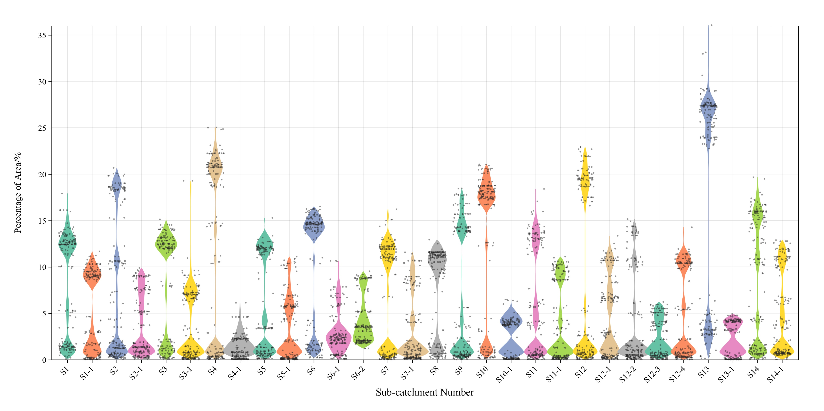

Slide 12
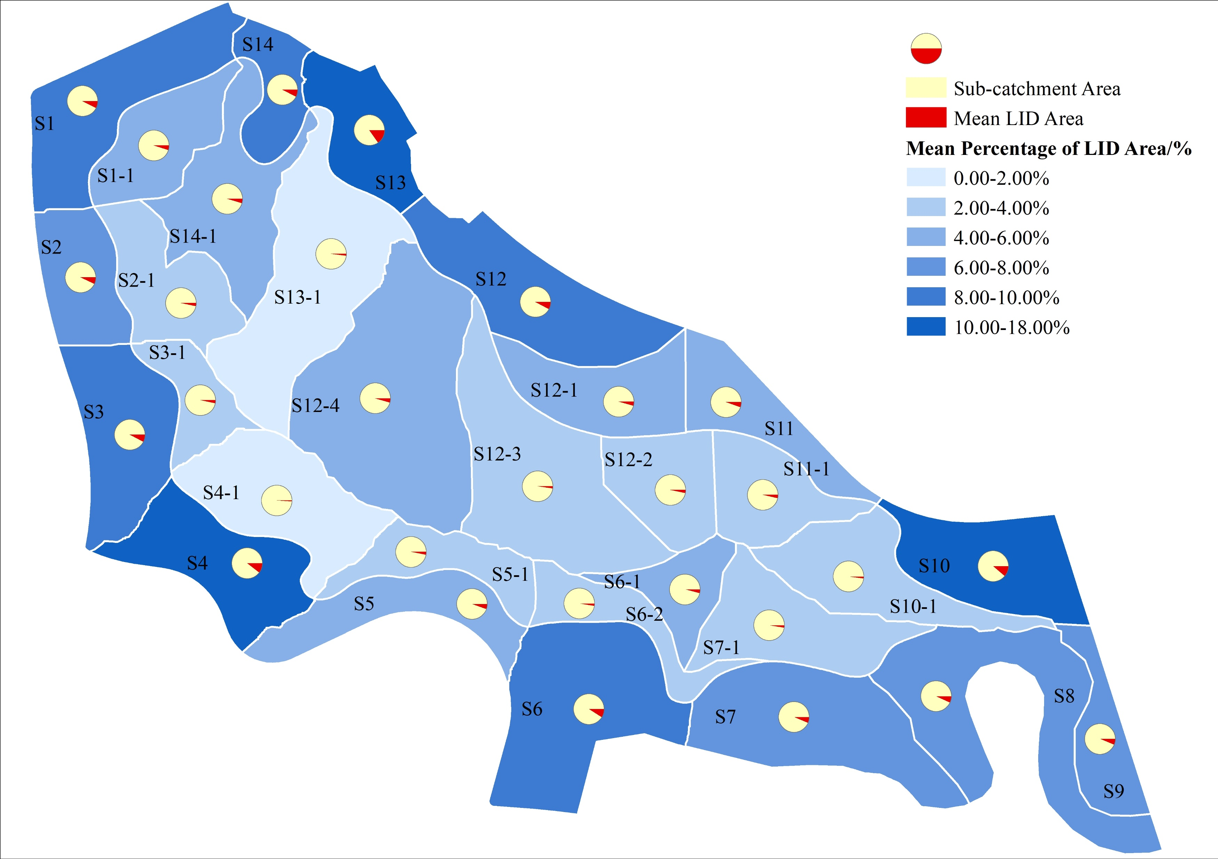

Slide 13
Max(Sink_area)
Min(earth_work_volume)

Slide 14
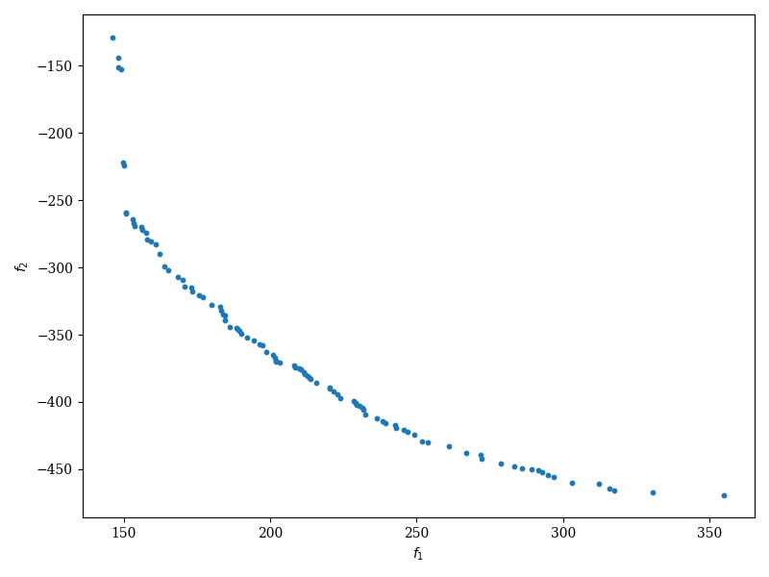
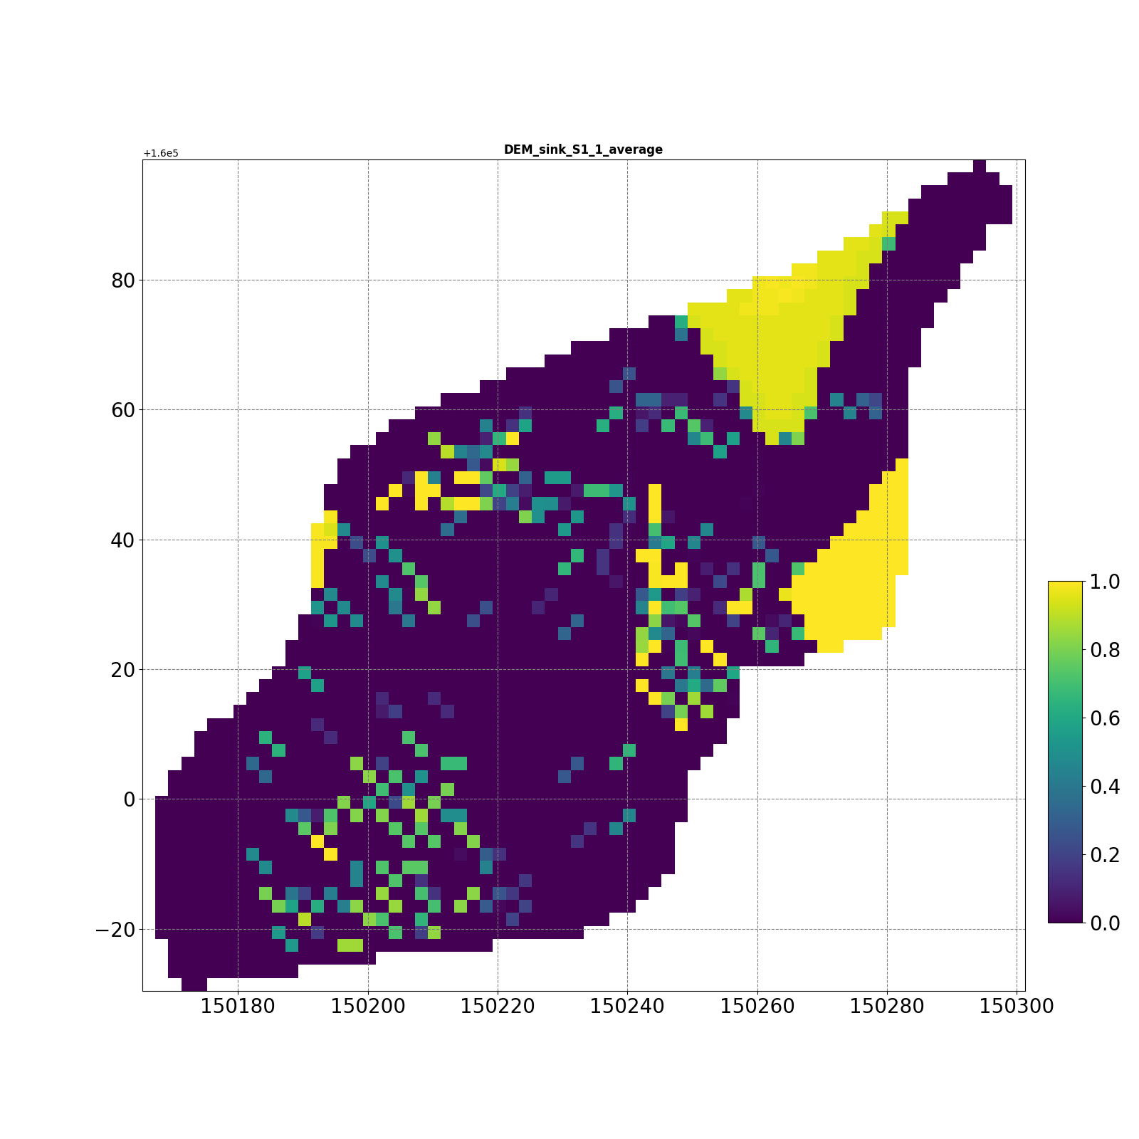
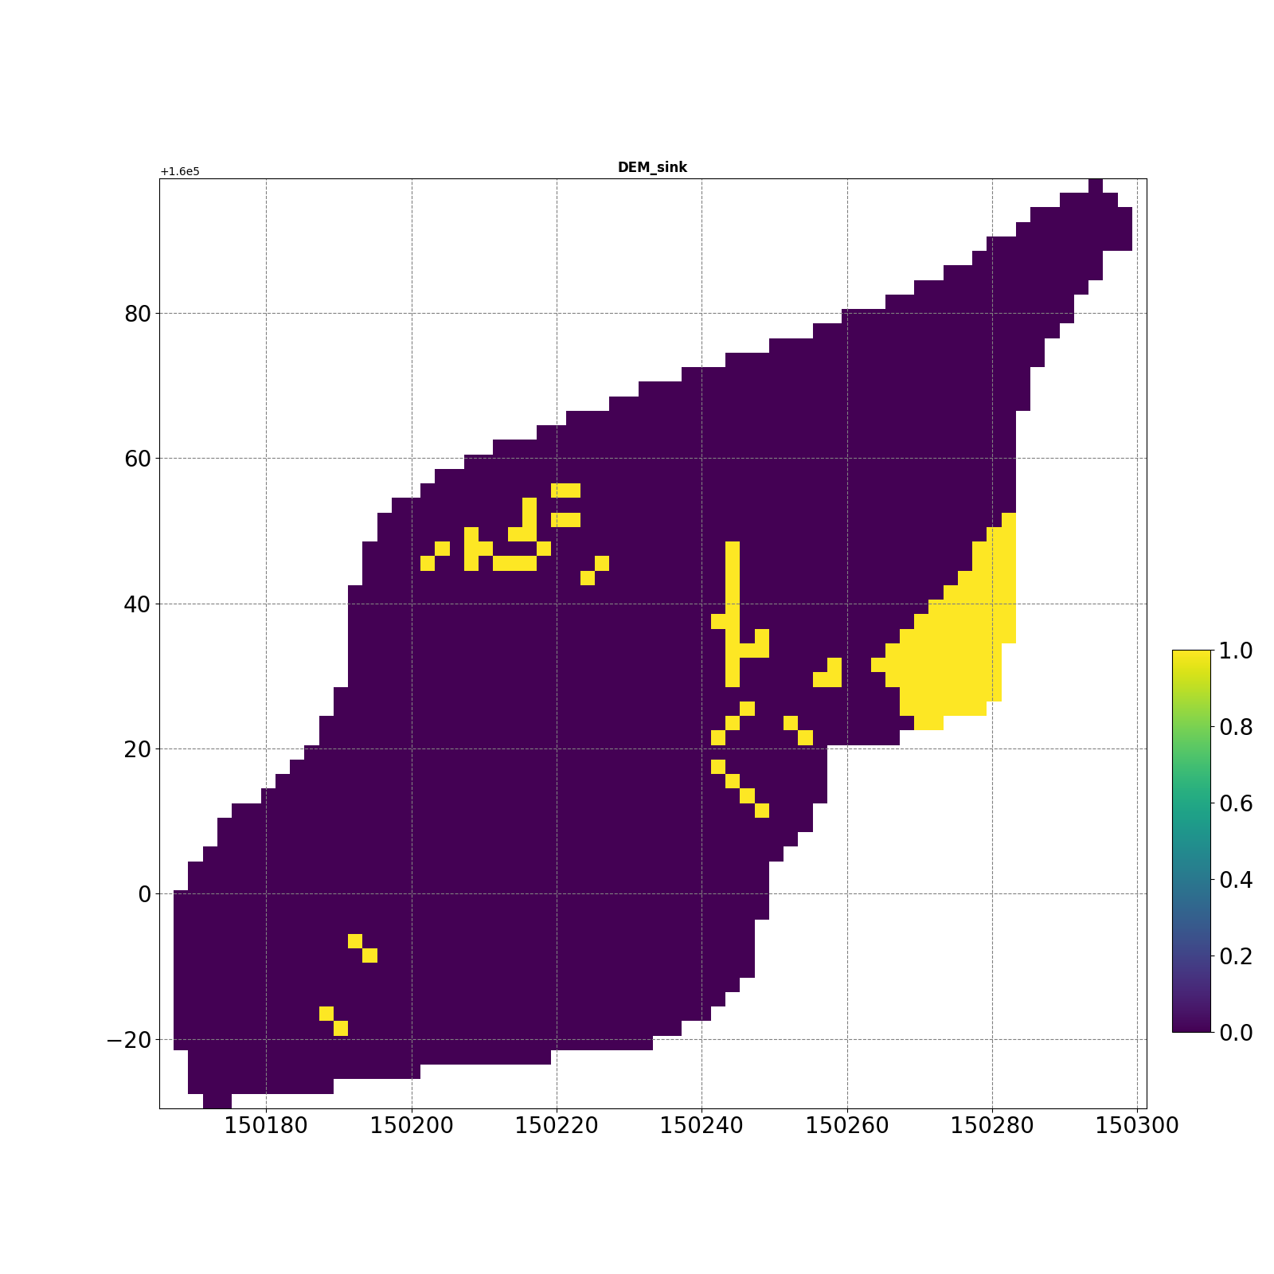
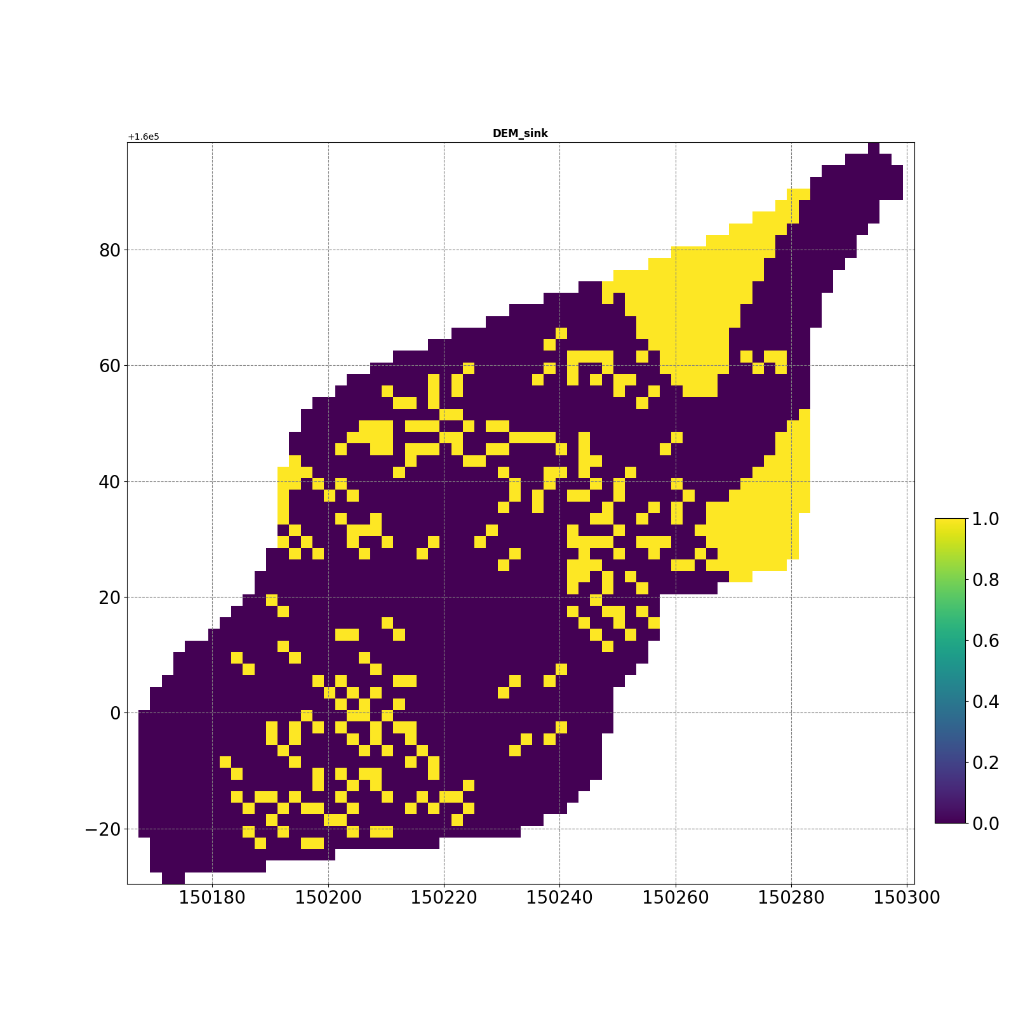
S1-1

Slide 15
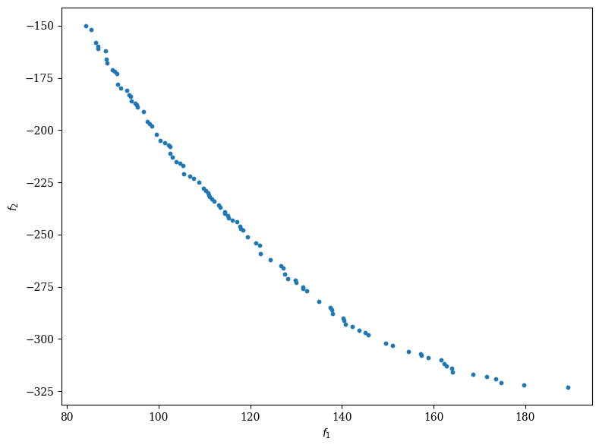
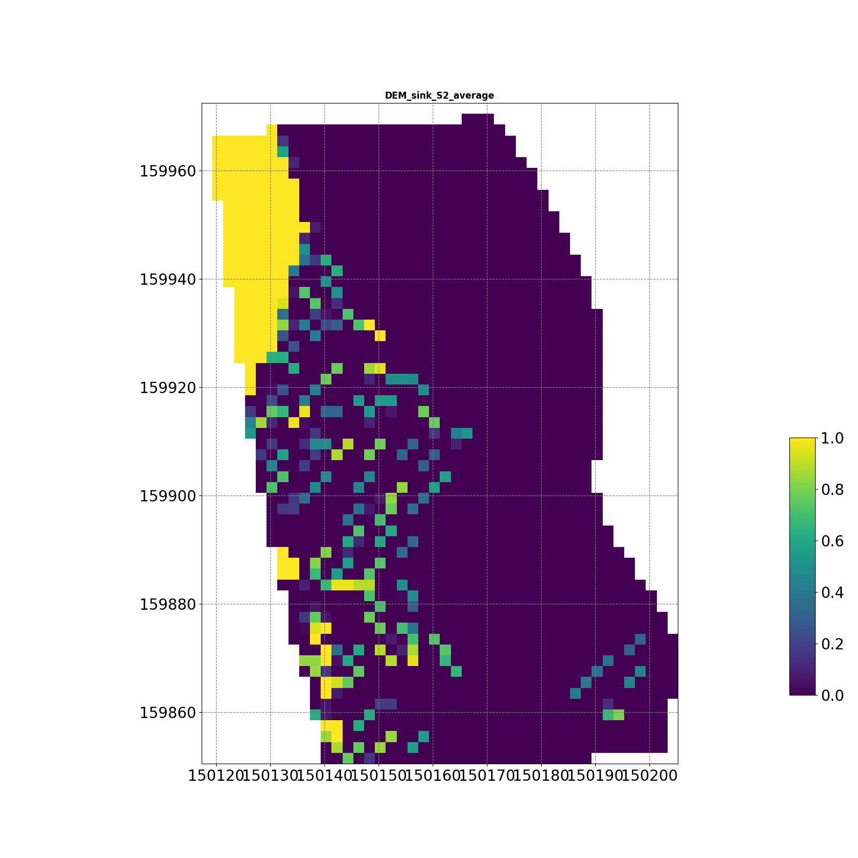
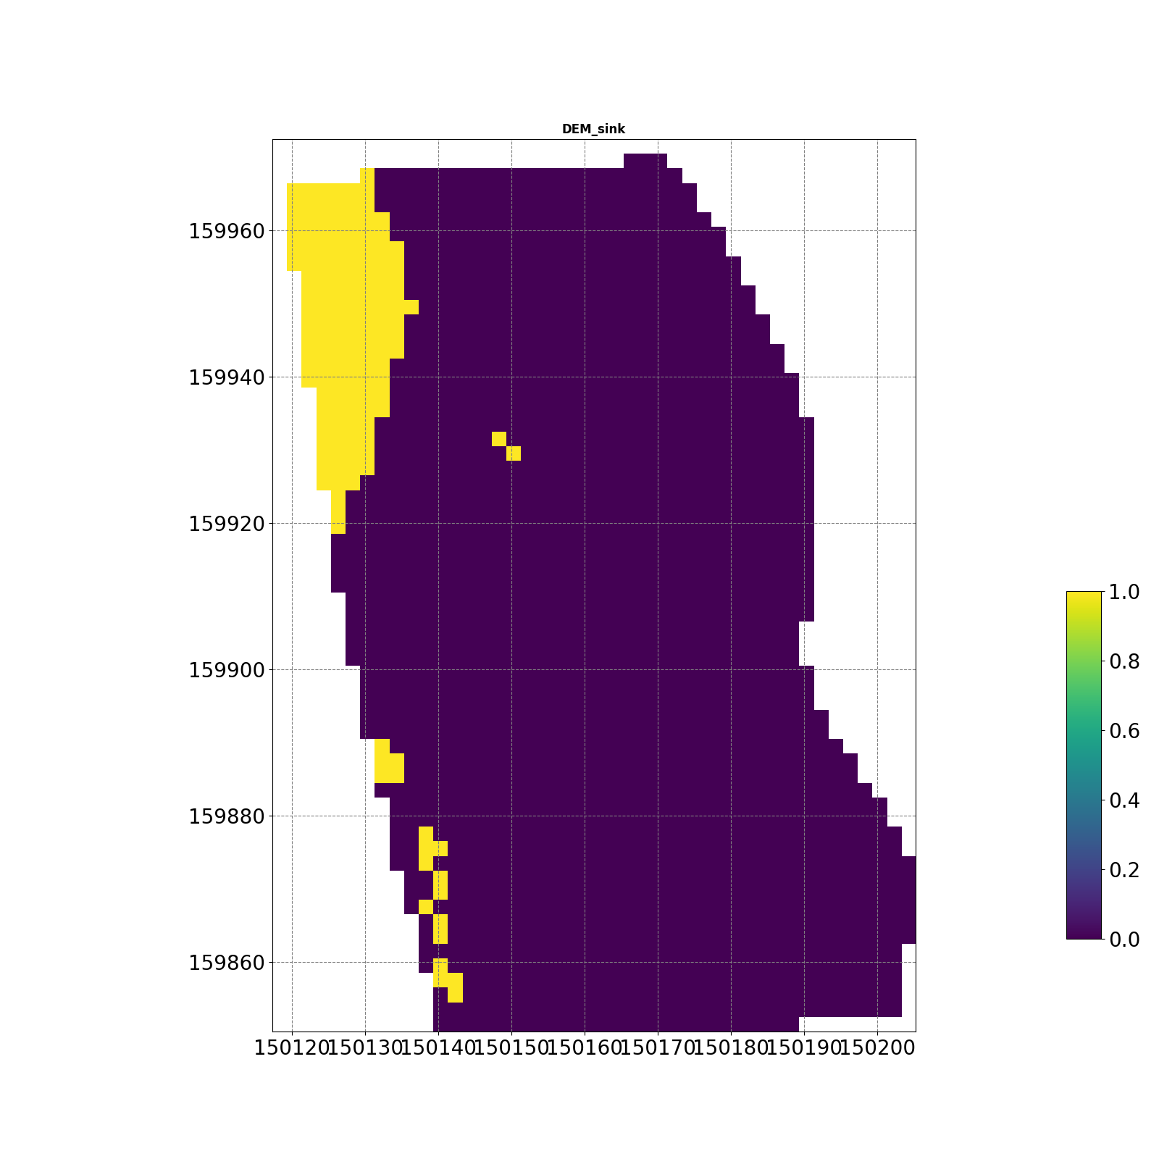
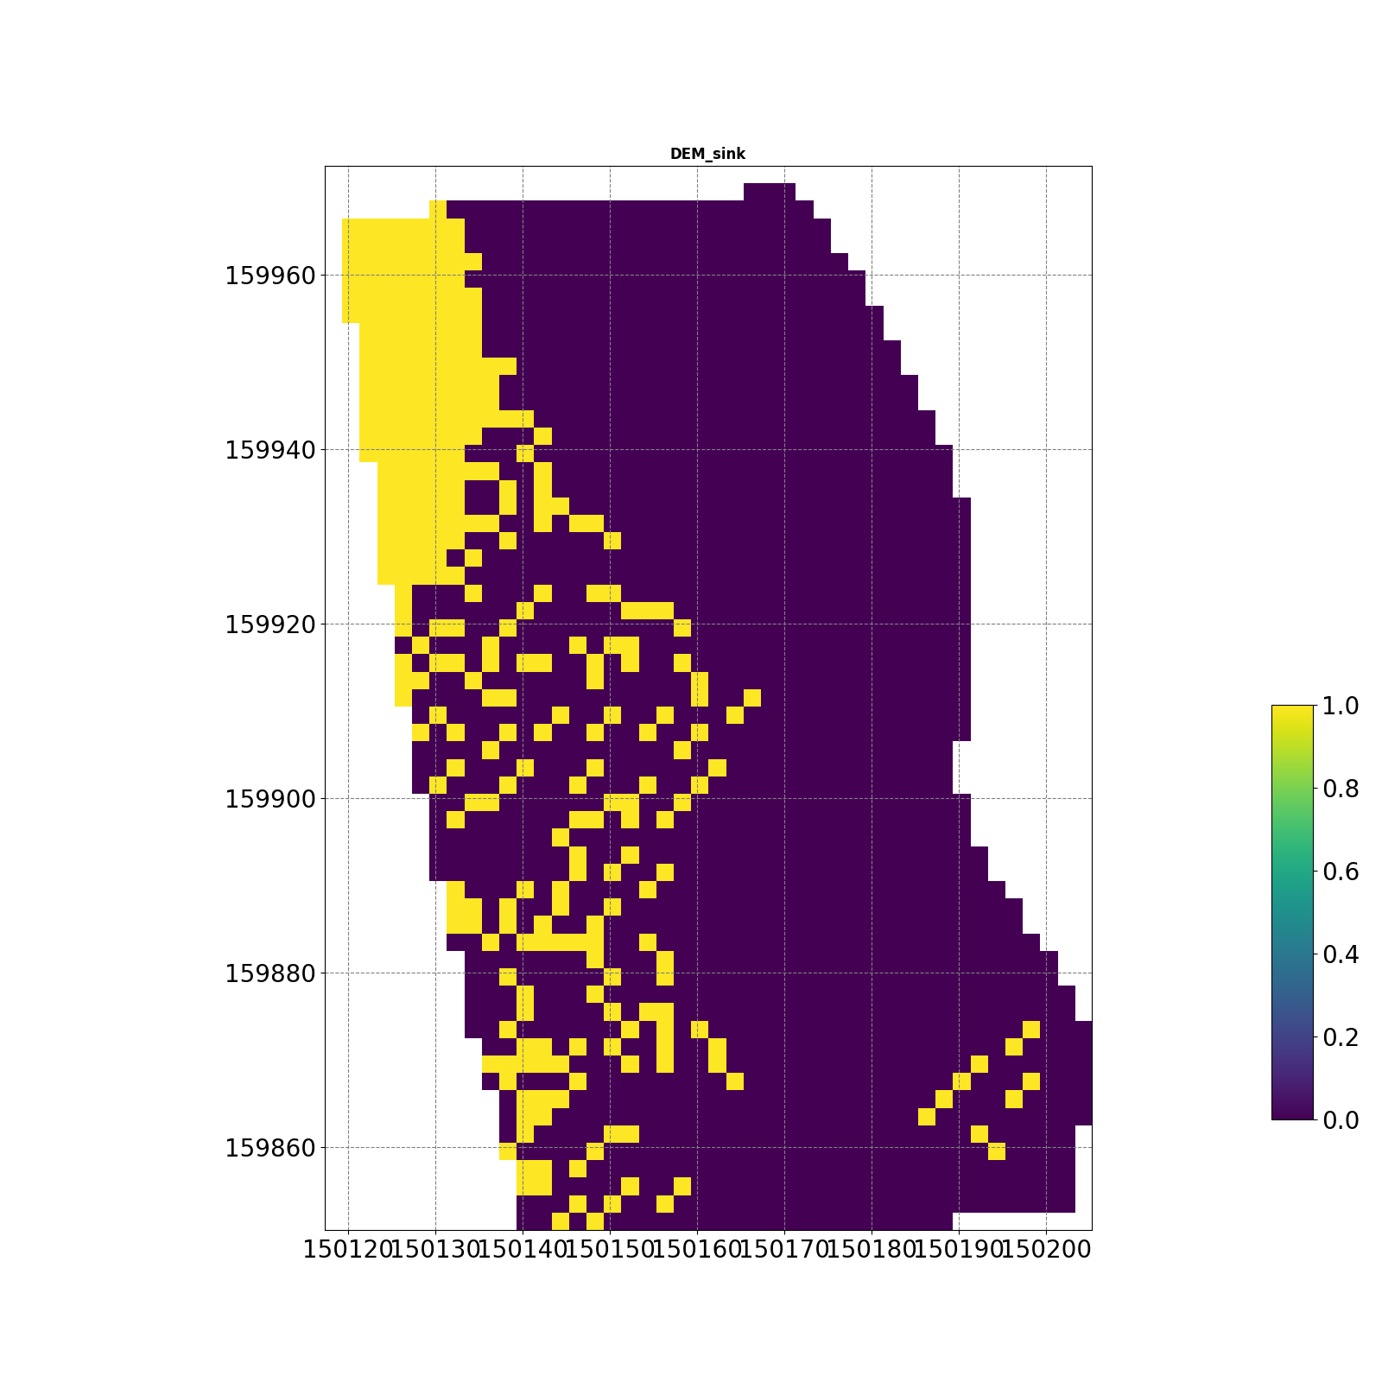
S2

Slide 16
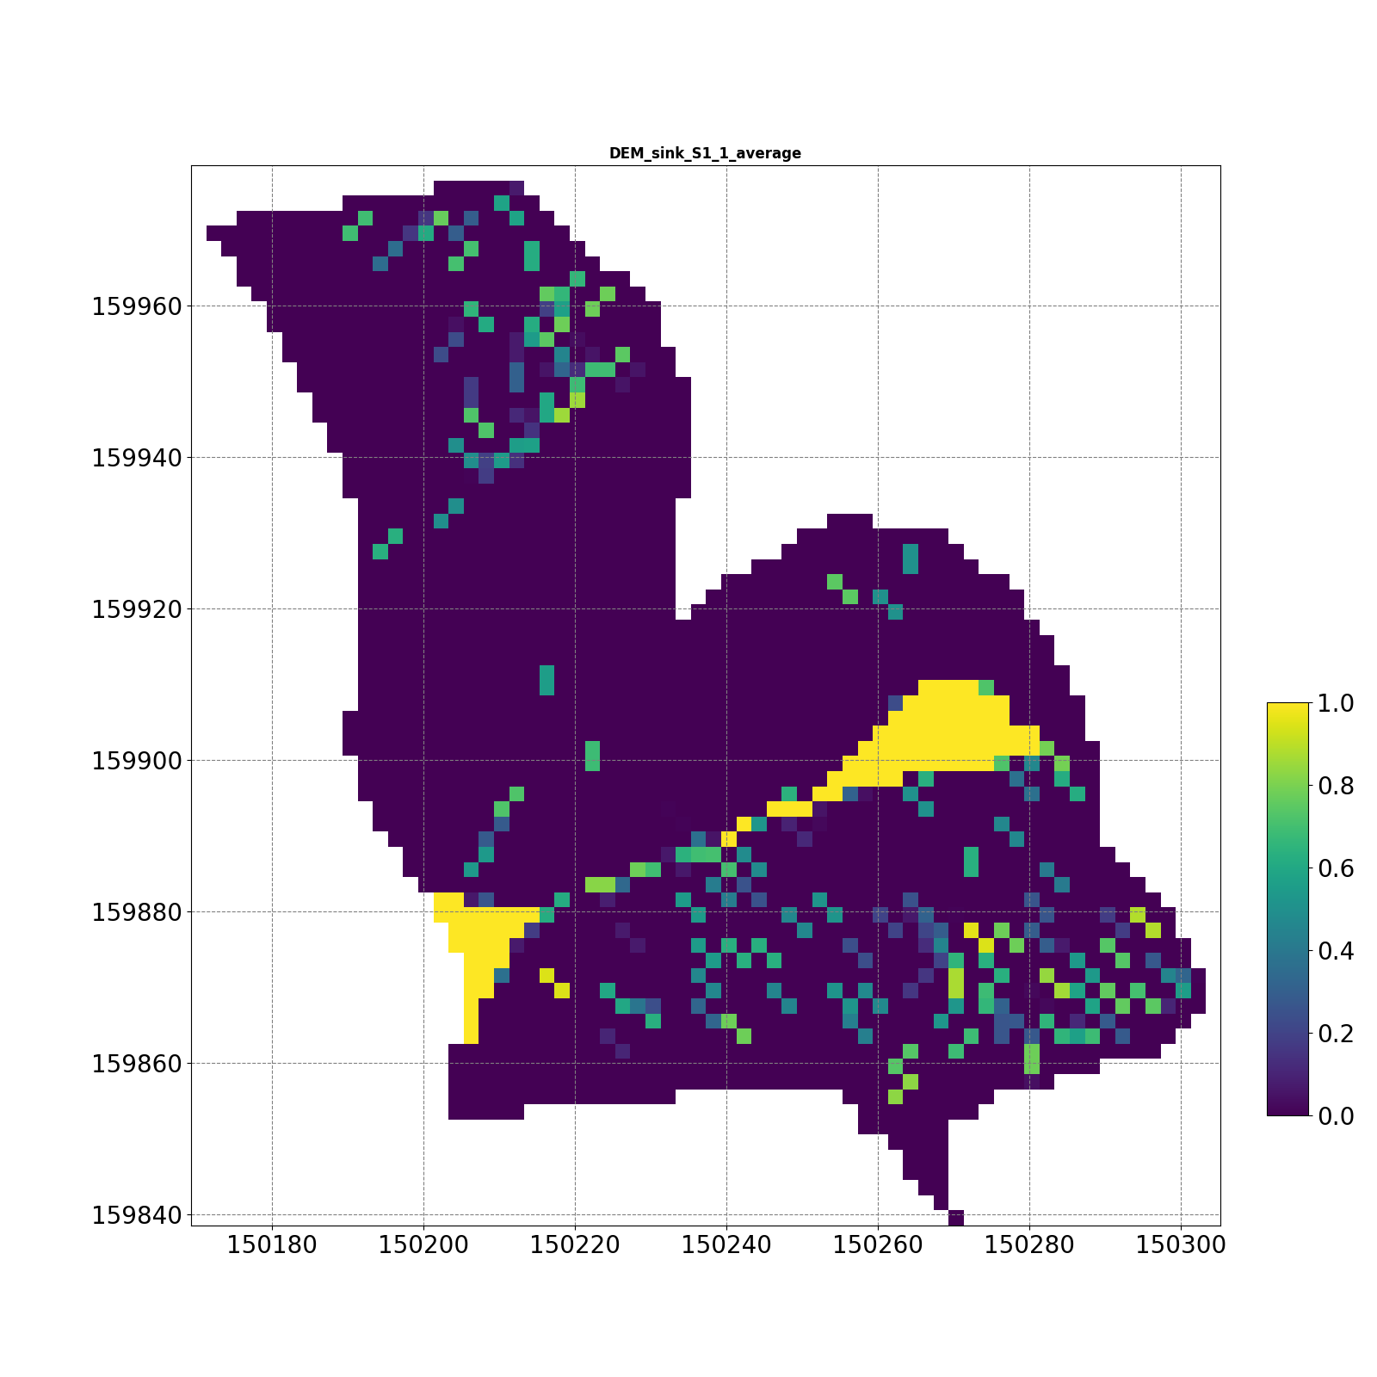
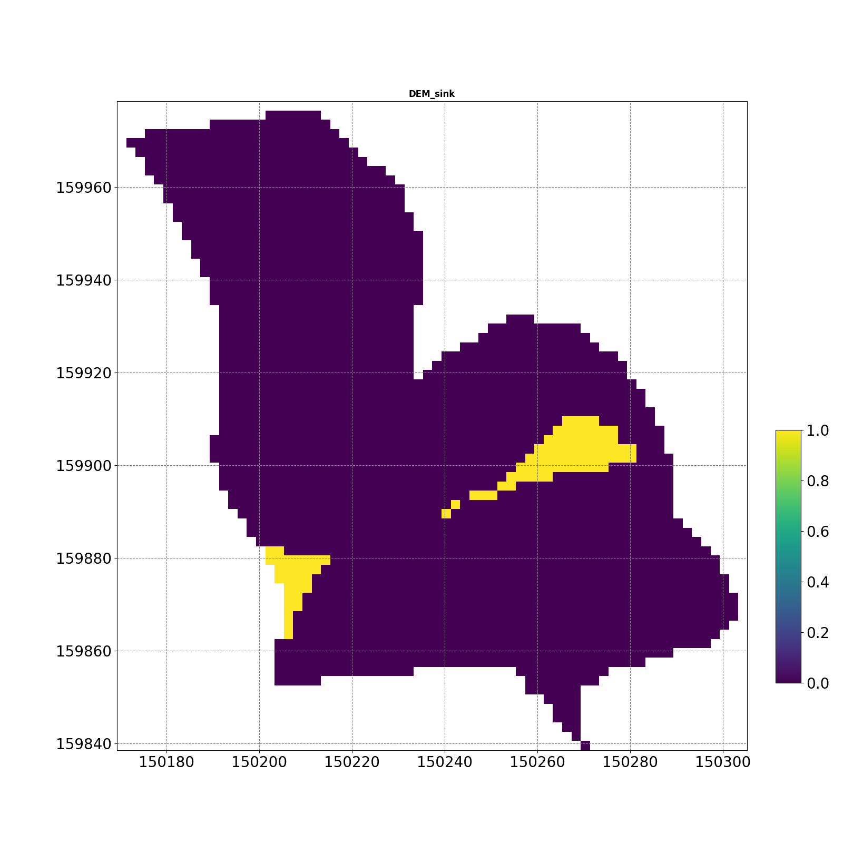
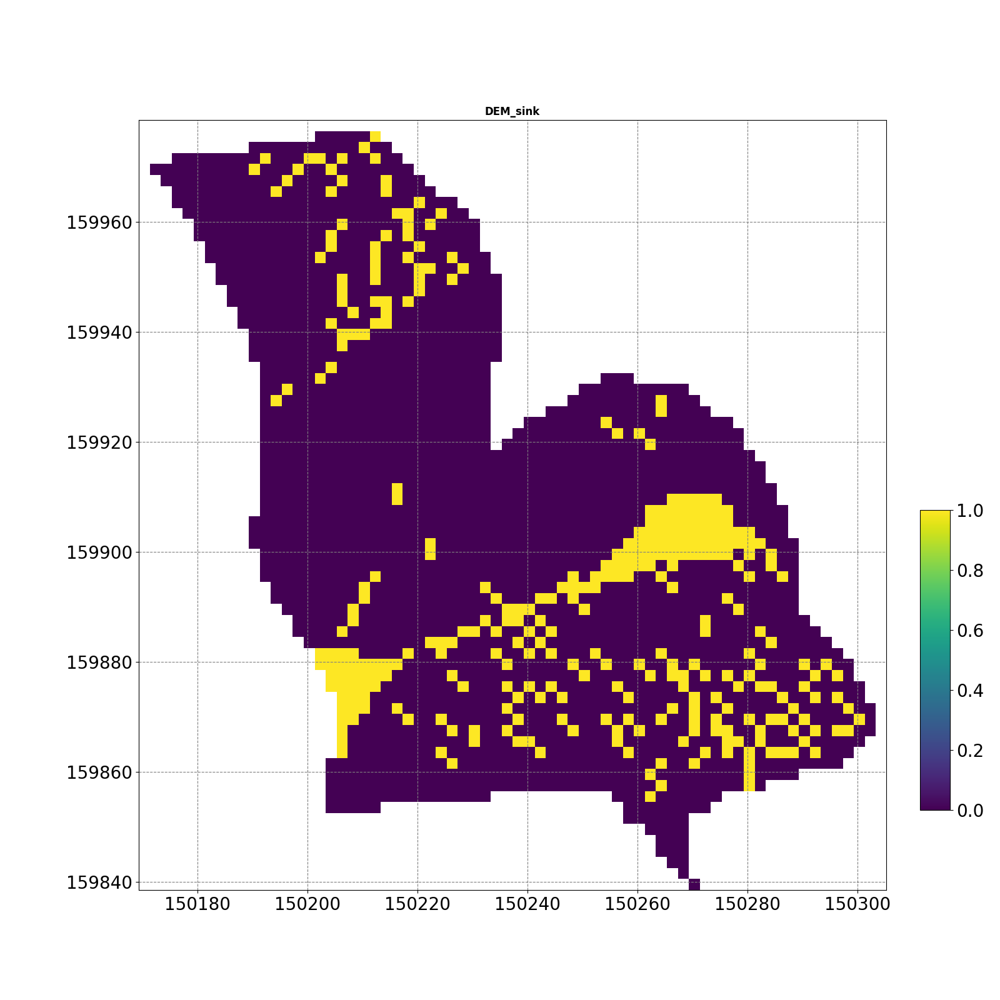
S2-1

Slide 17
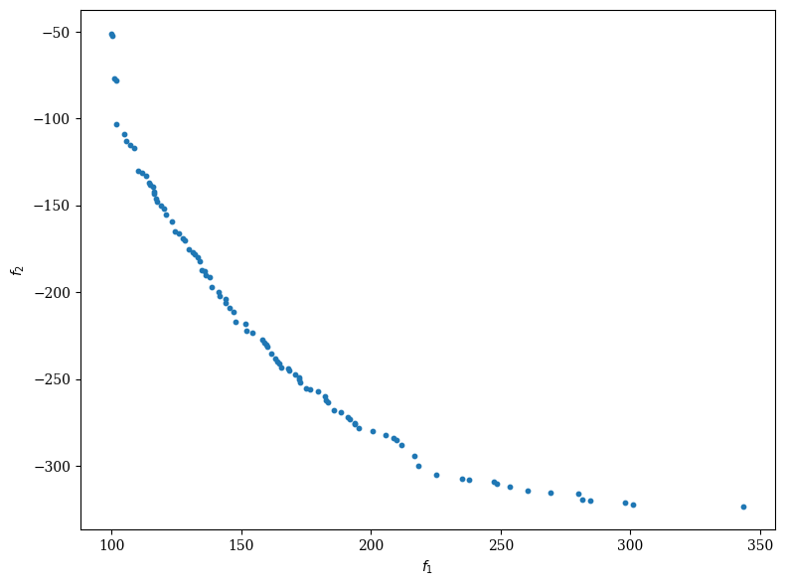
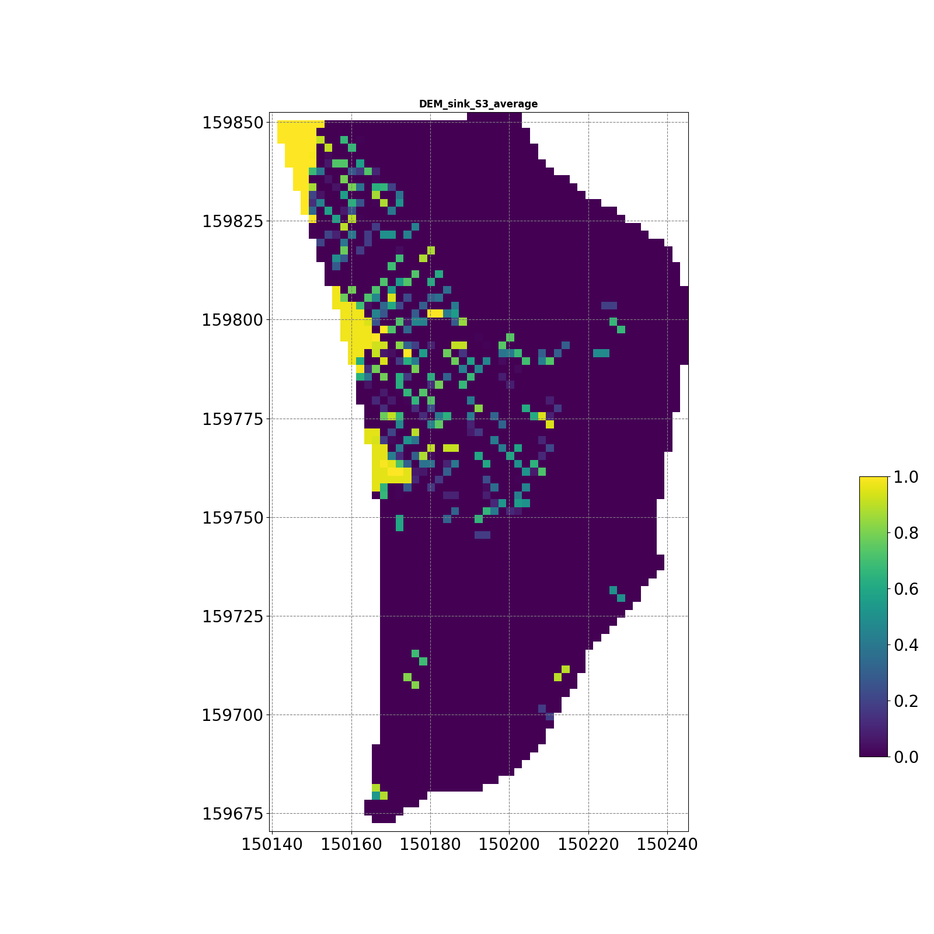
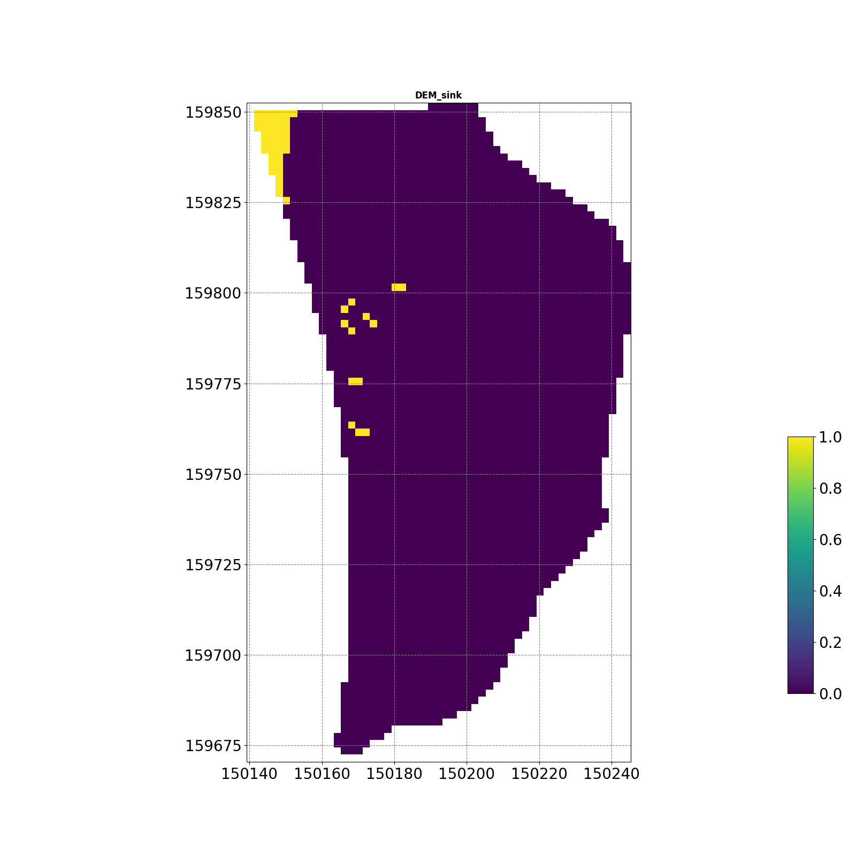
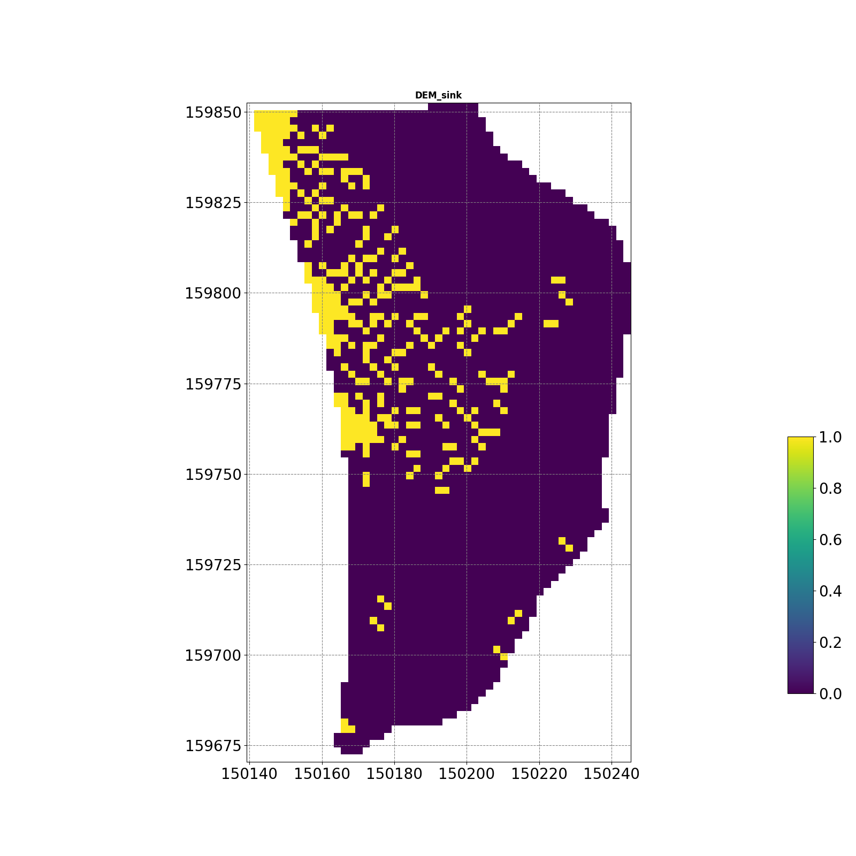
S3

Slide 18
S3-1

Slide 19
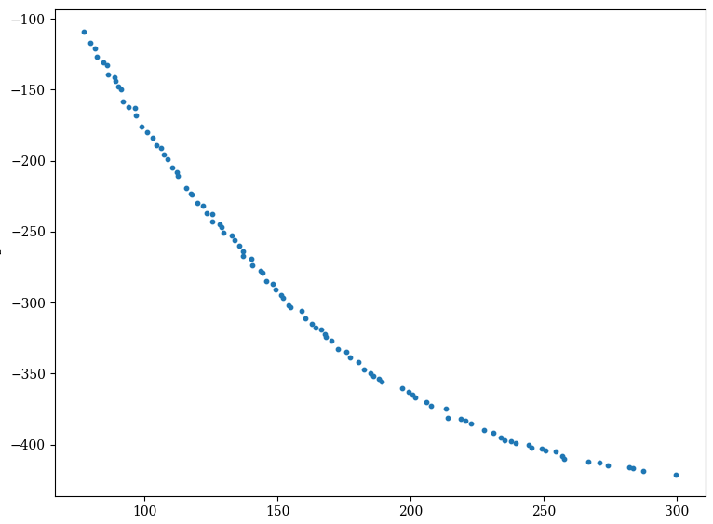
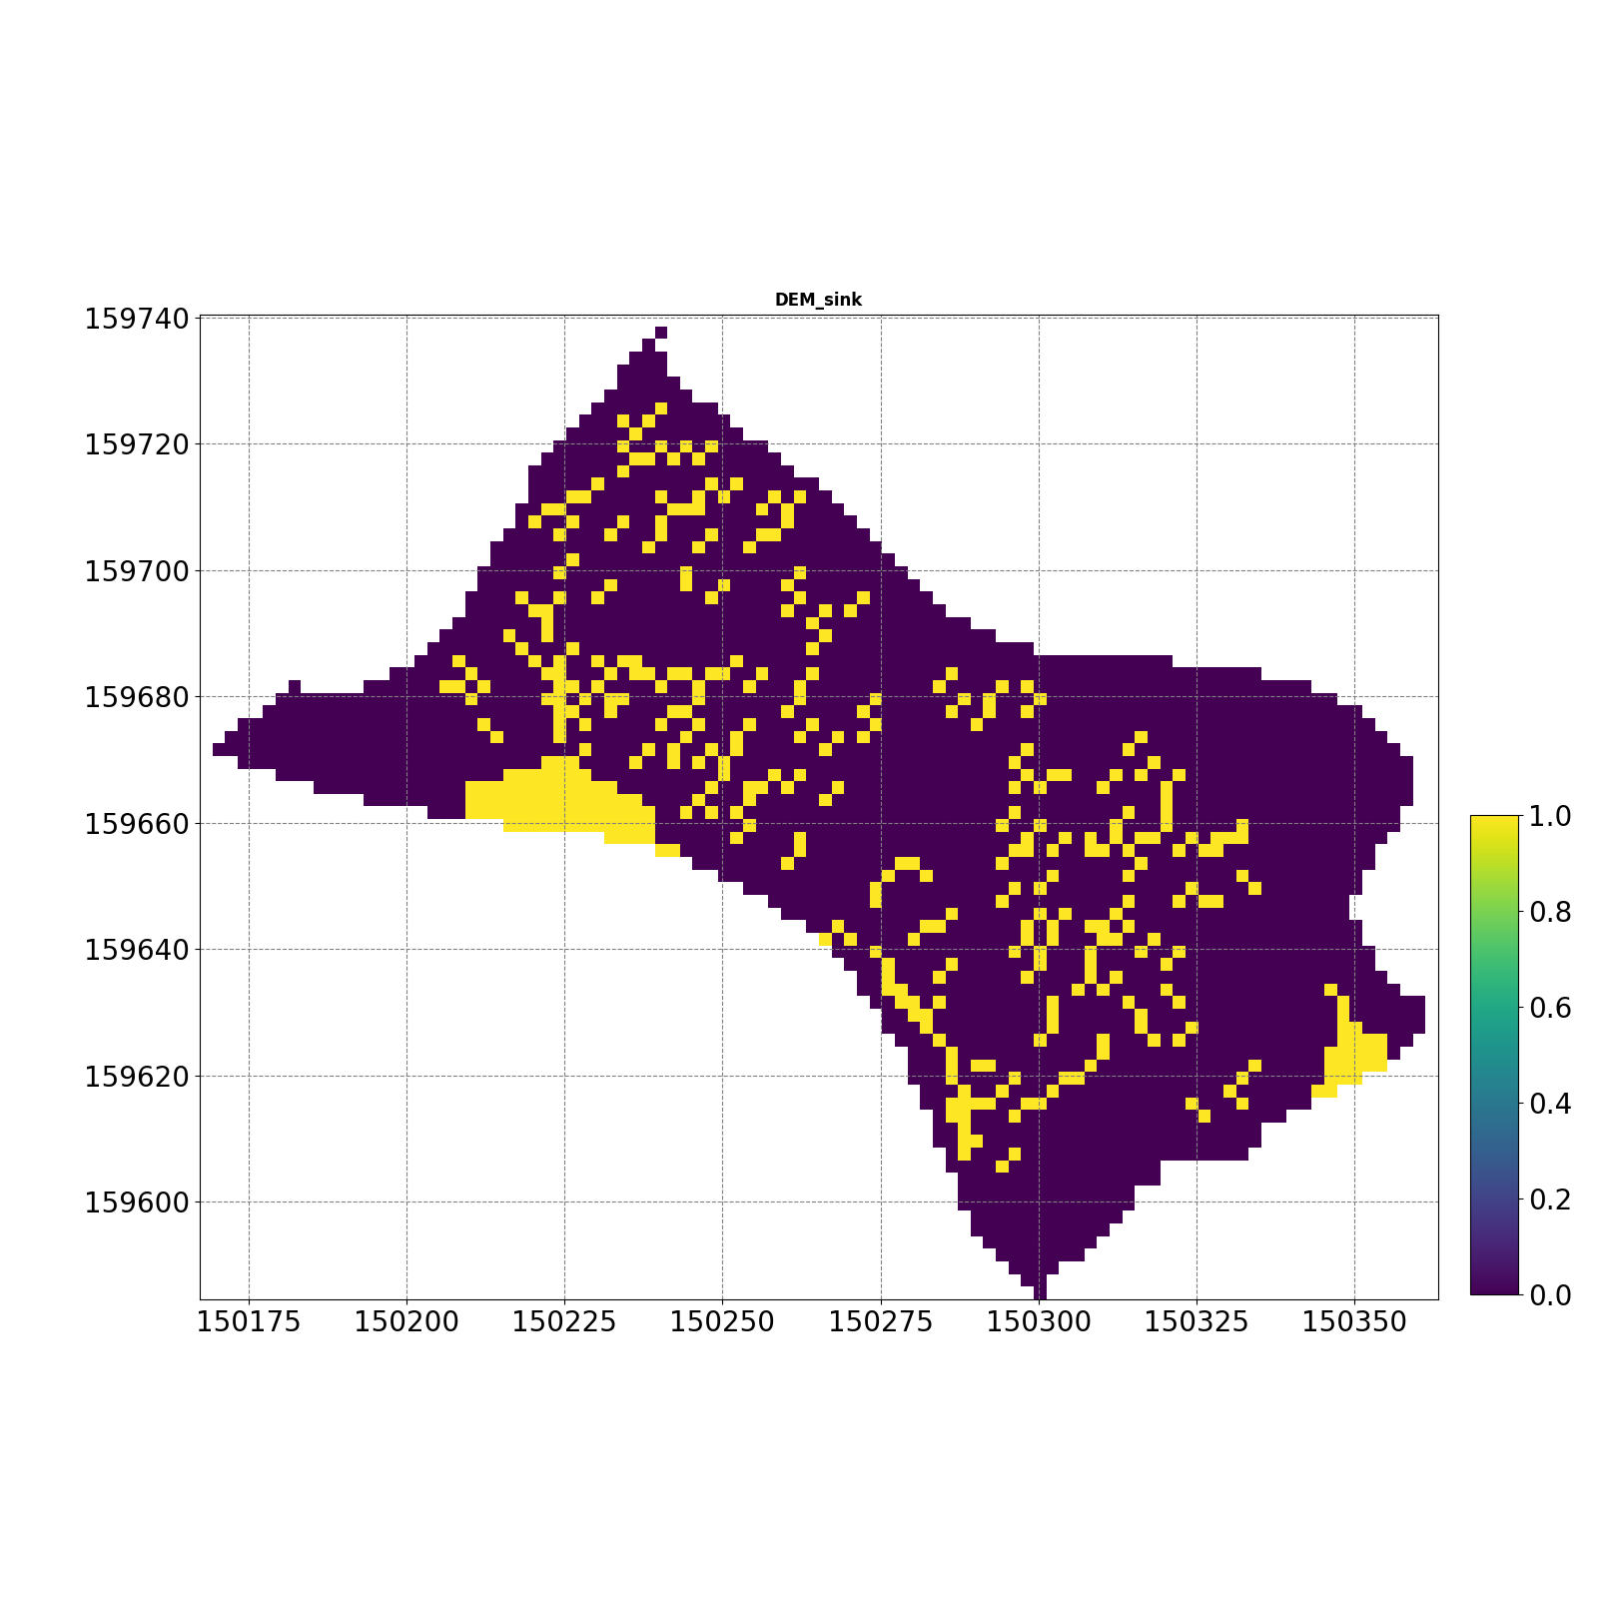
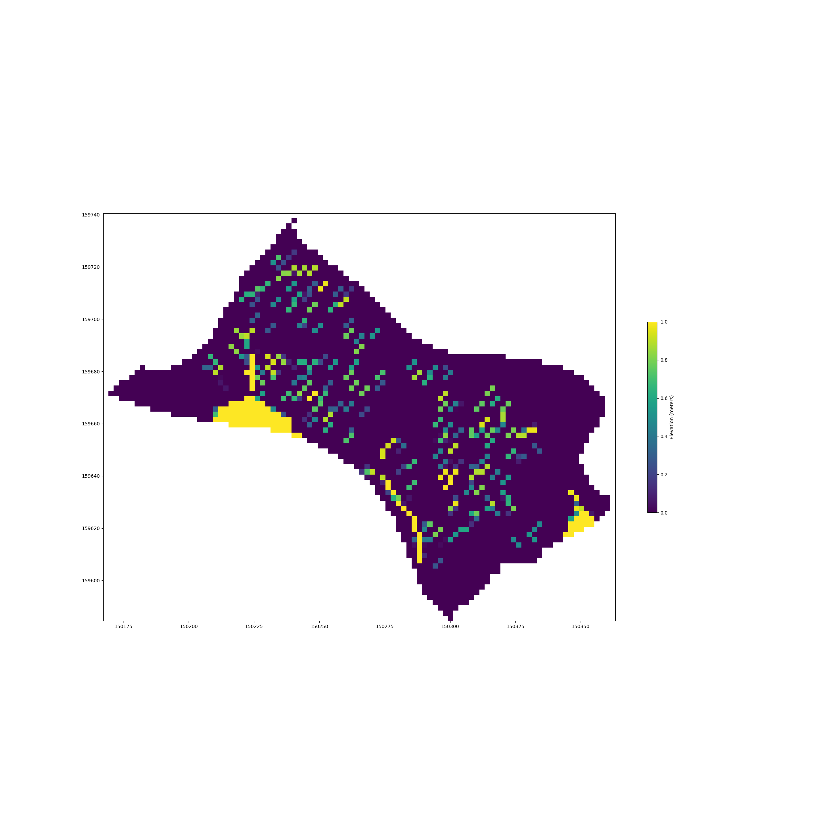
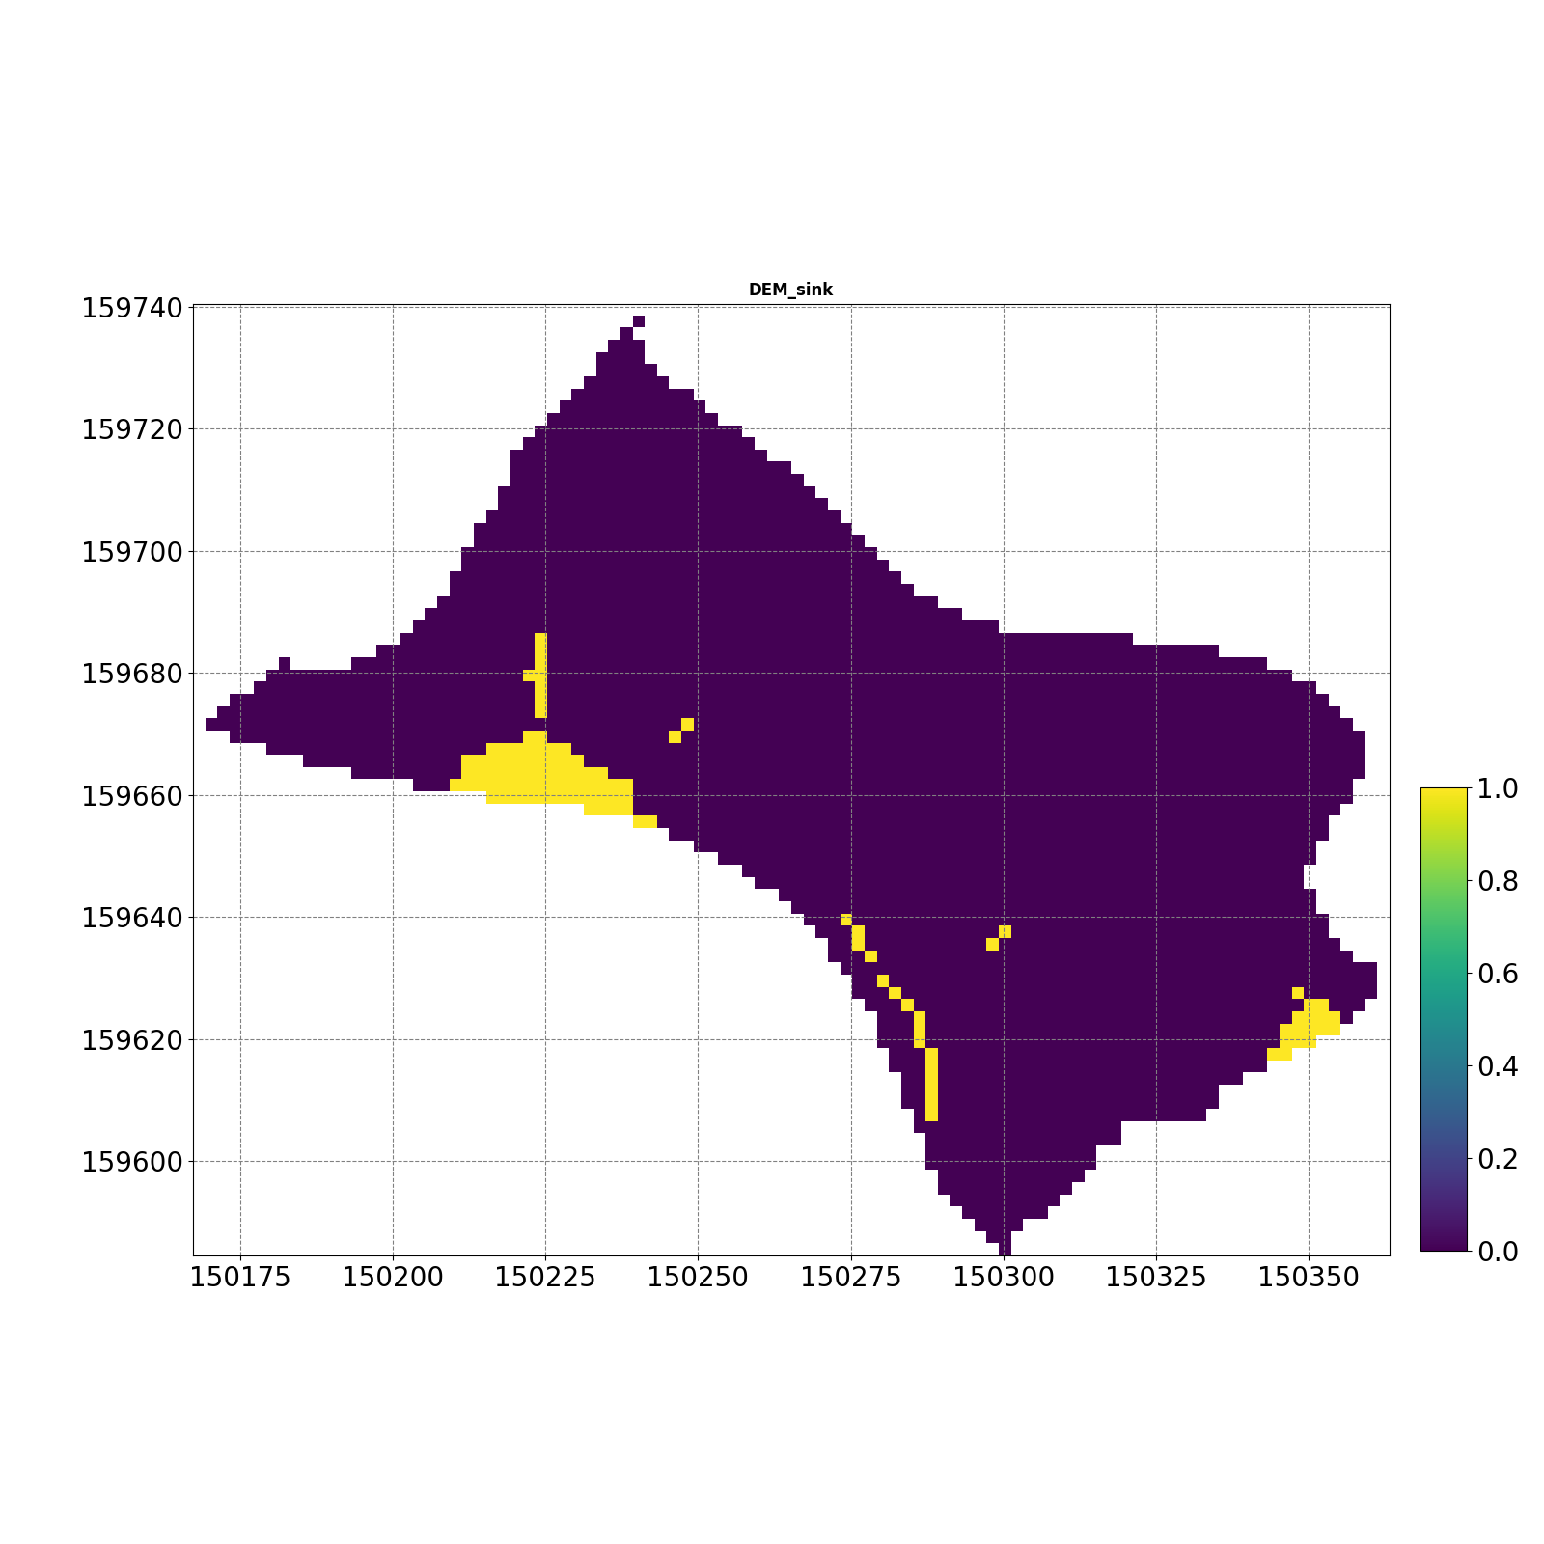
S4

Slide 20
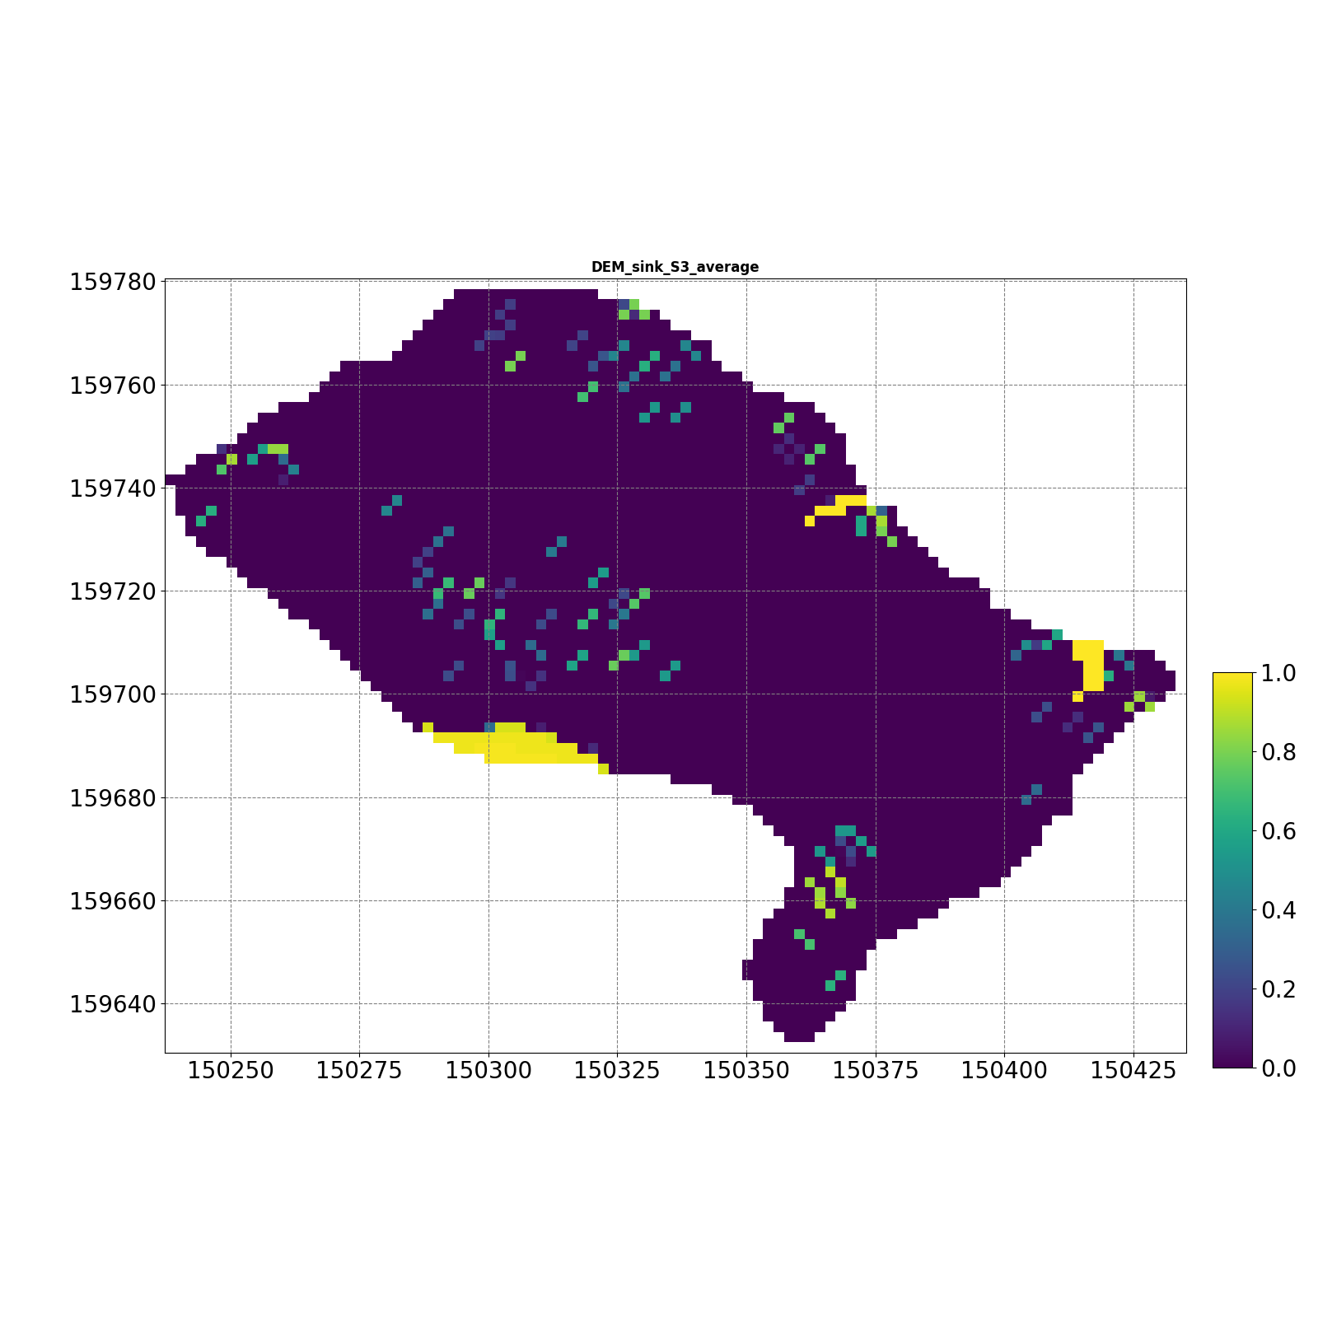
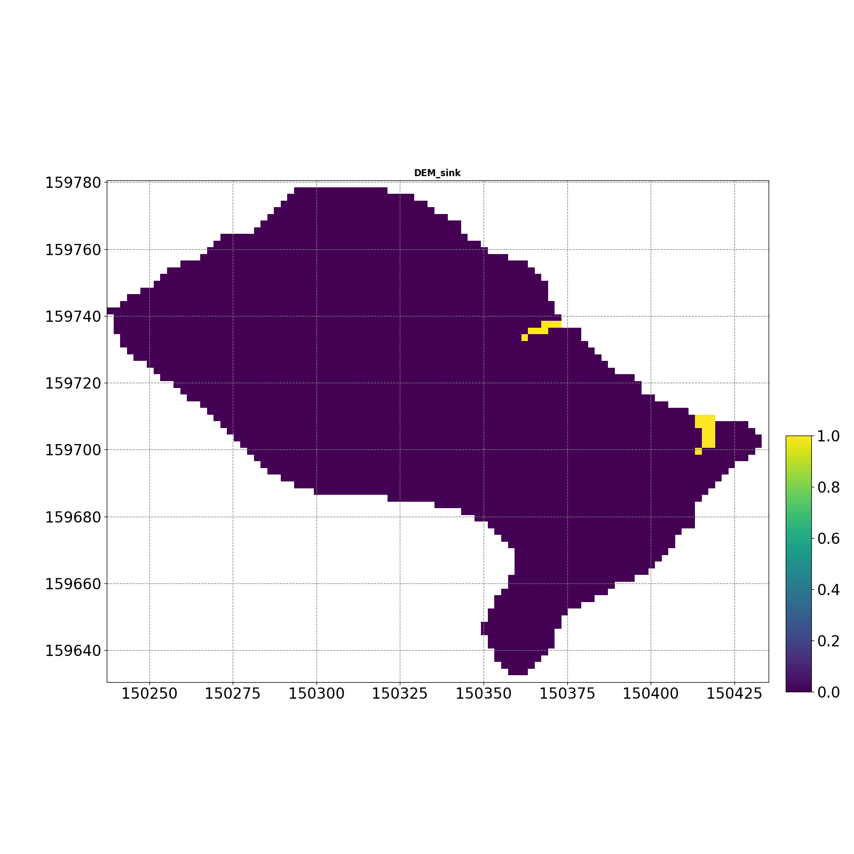

S4-1

Slide 21
S5

Slide 22
S5-1

Slide 23
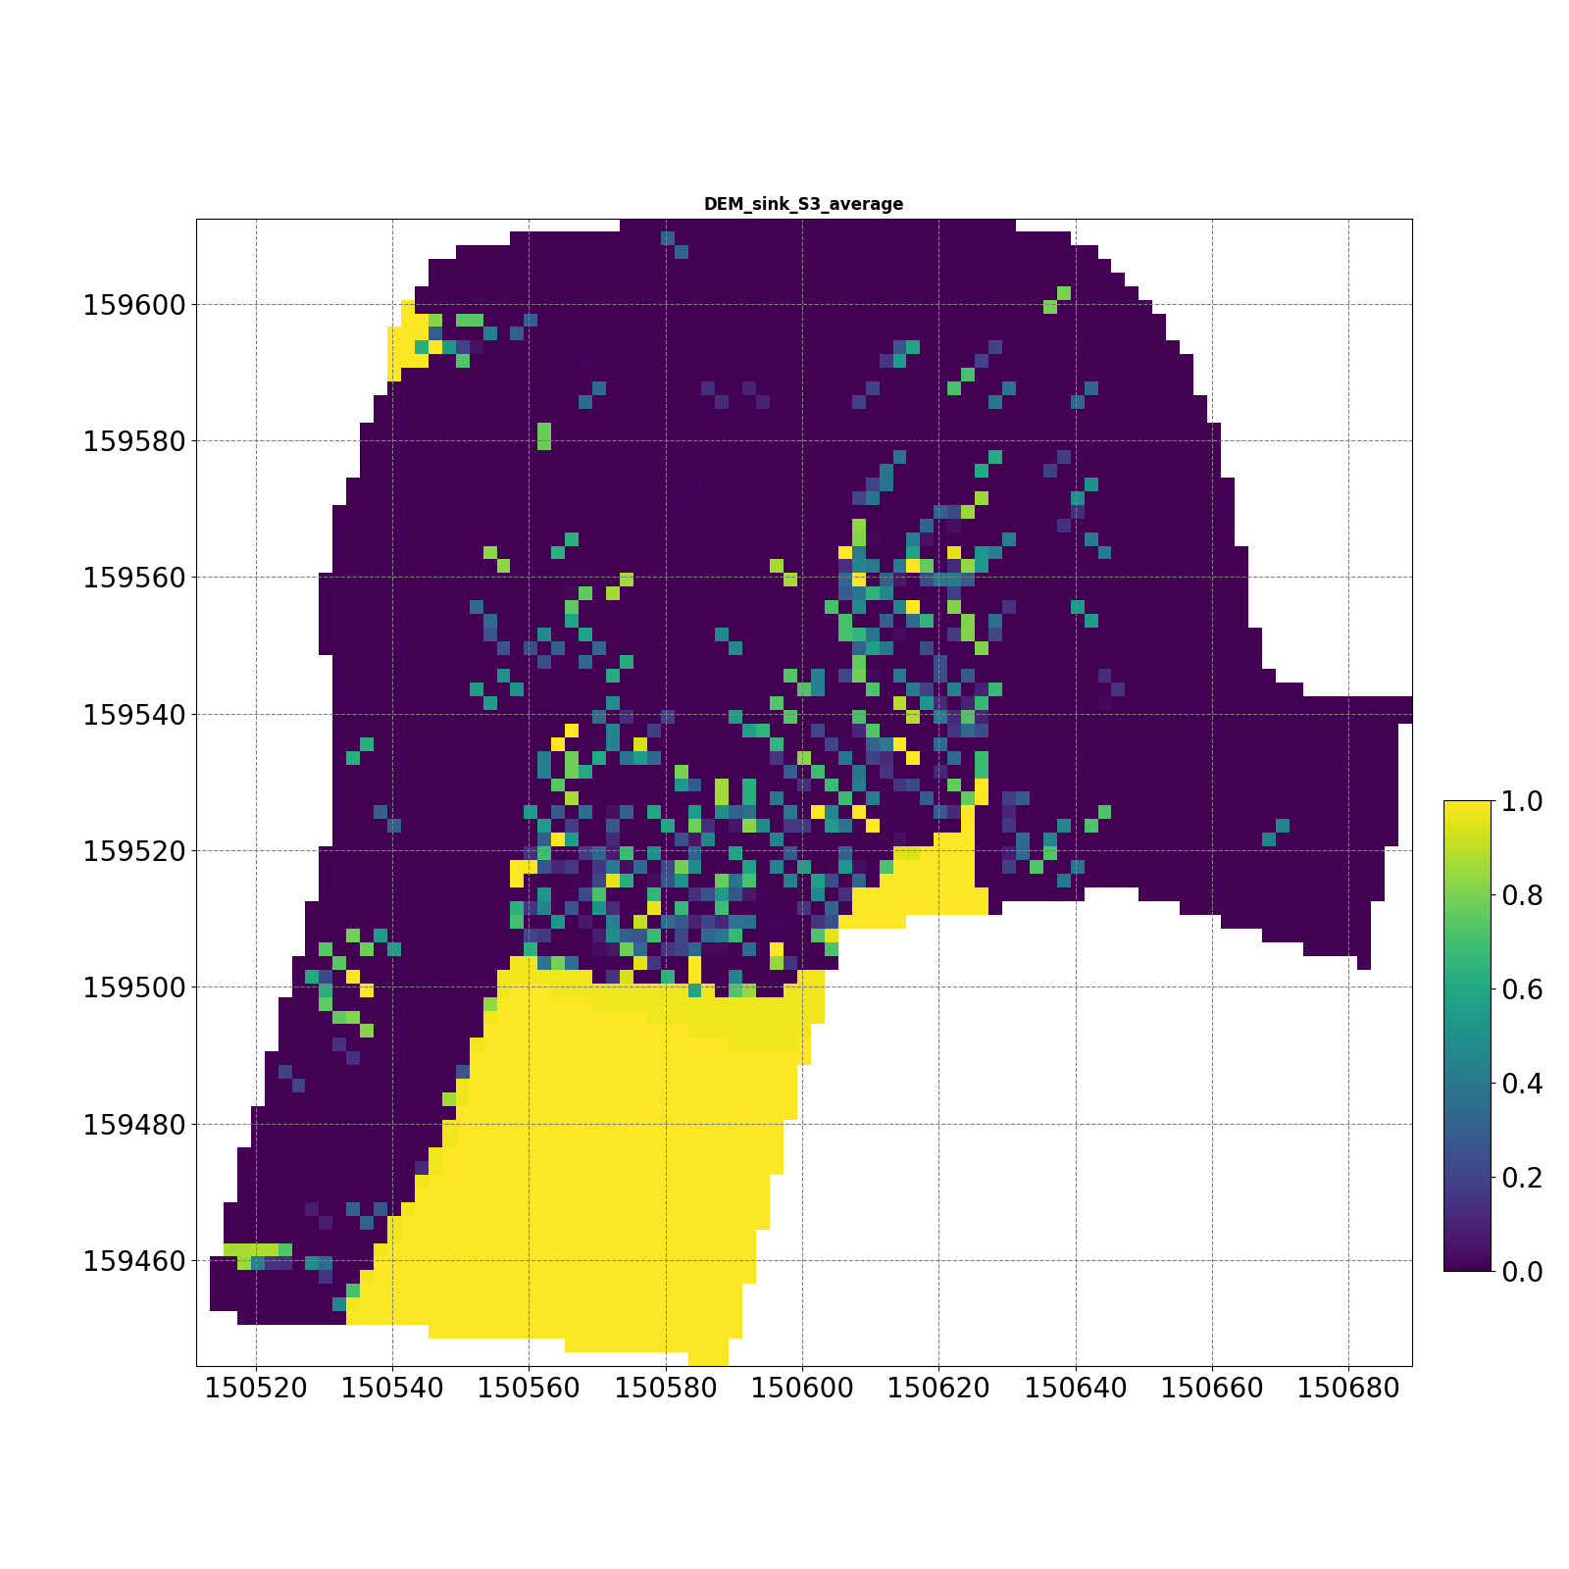
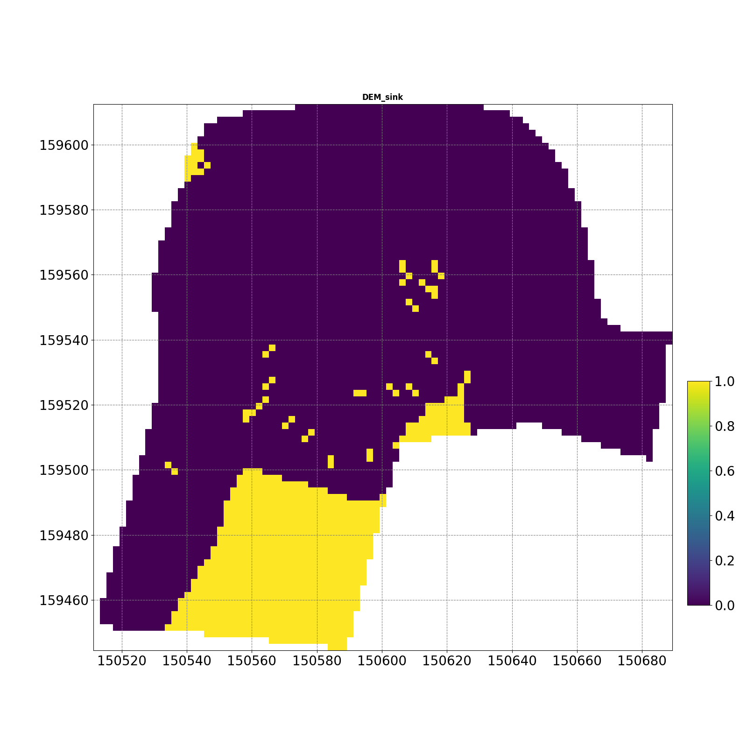
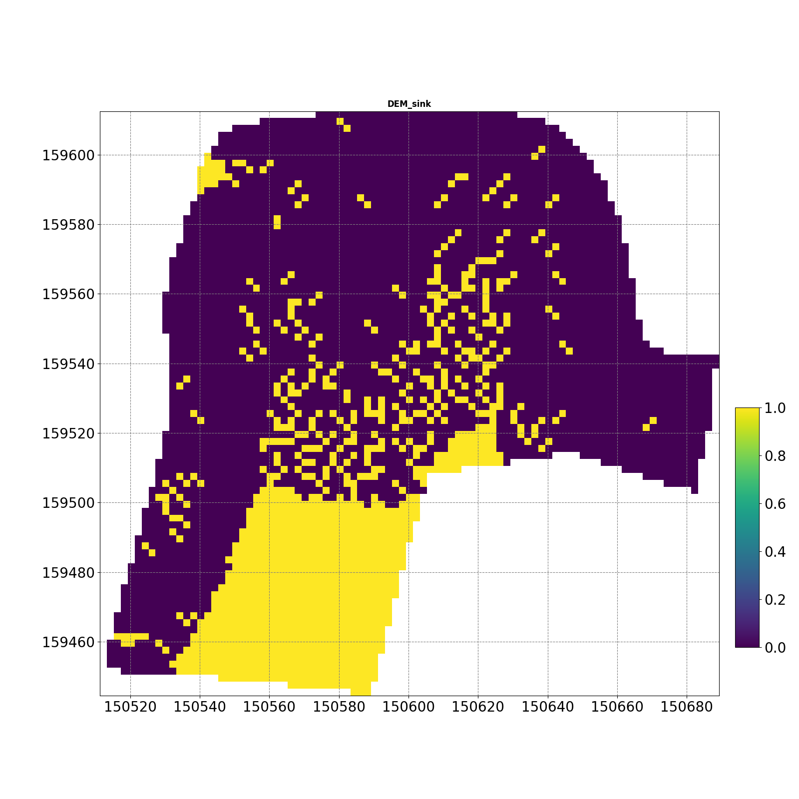
S6

Slide 24
S6-1

Slide 25
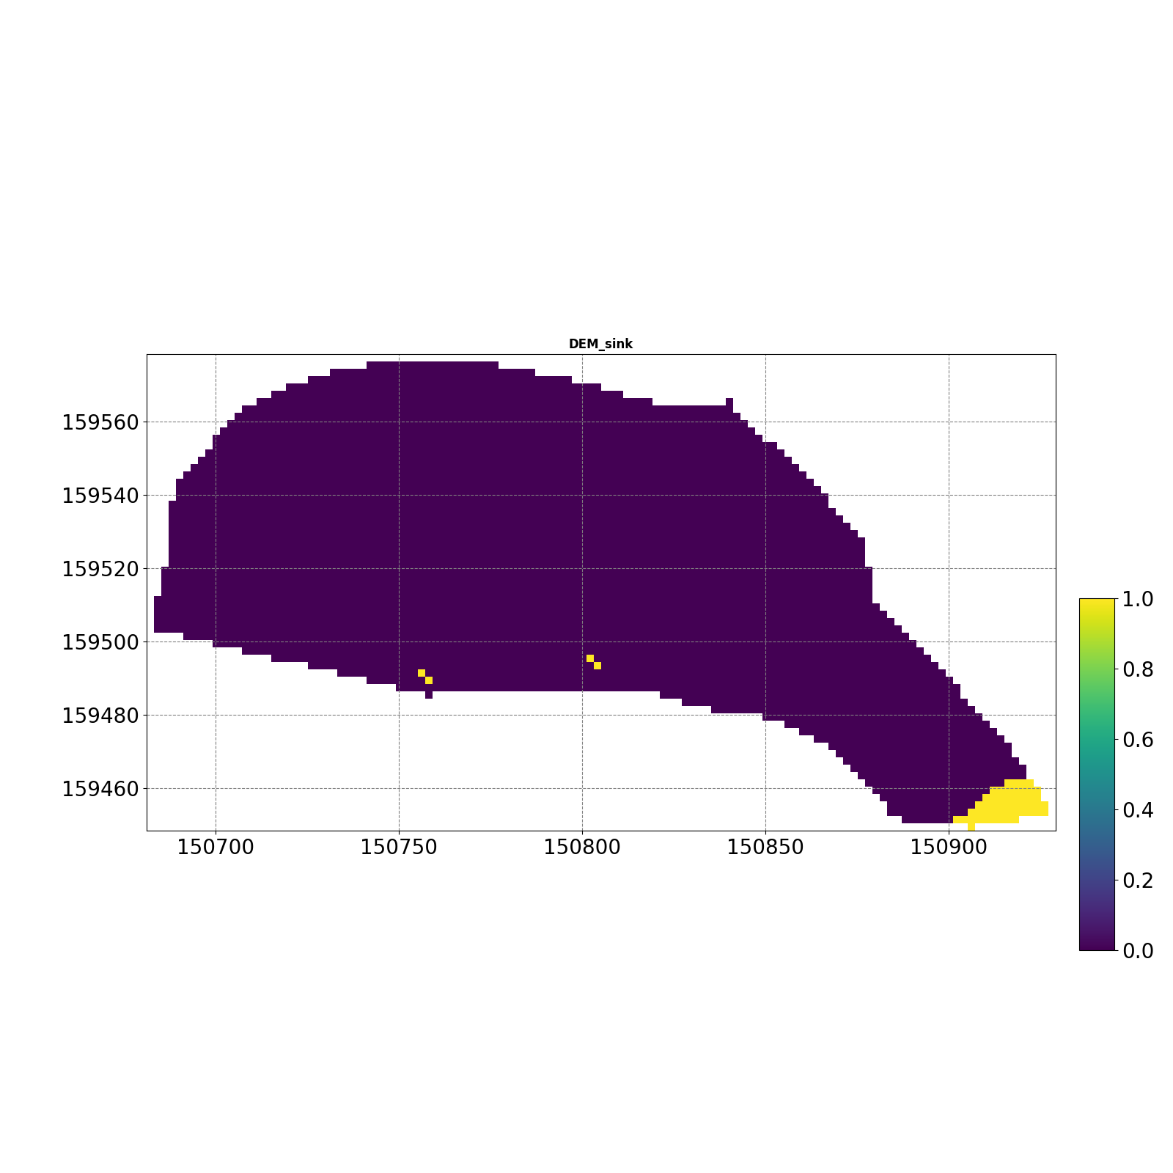
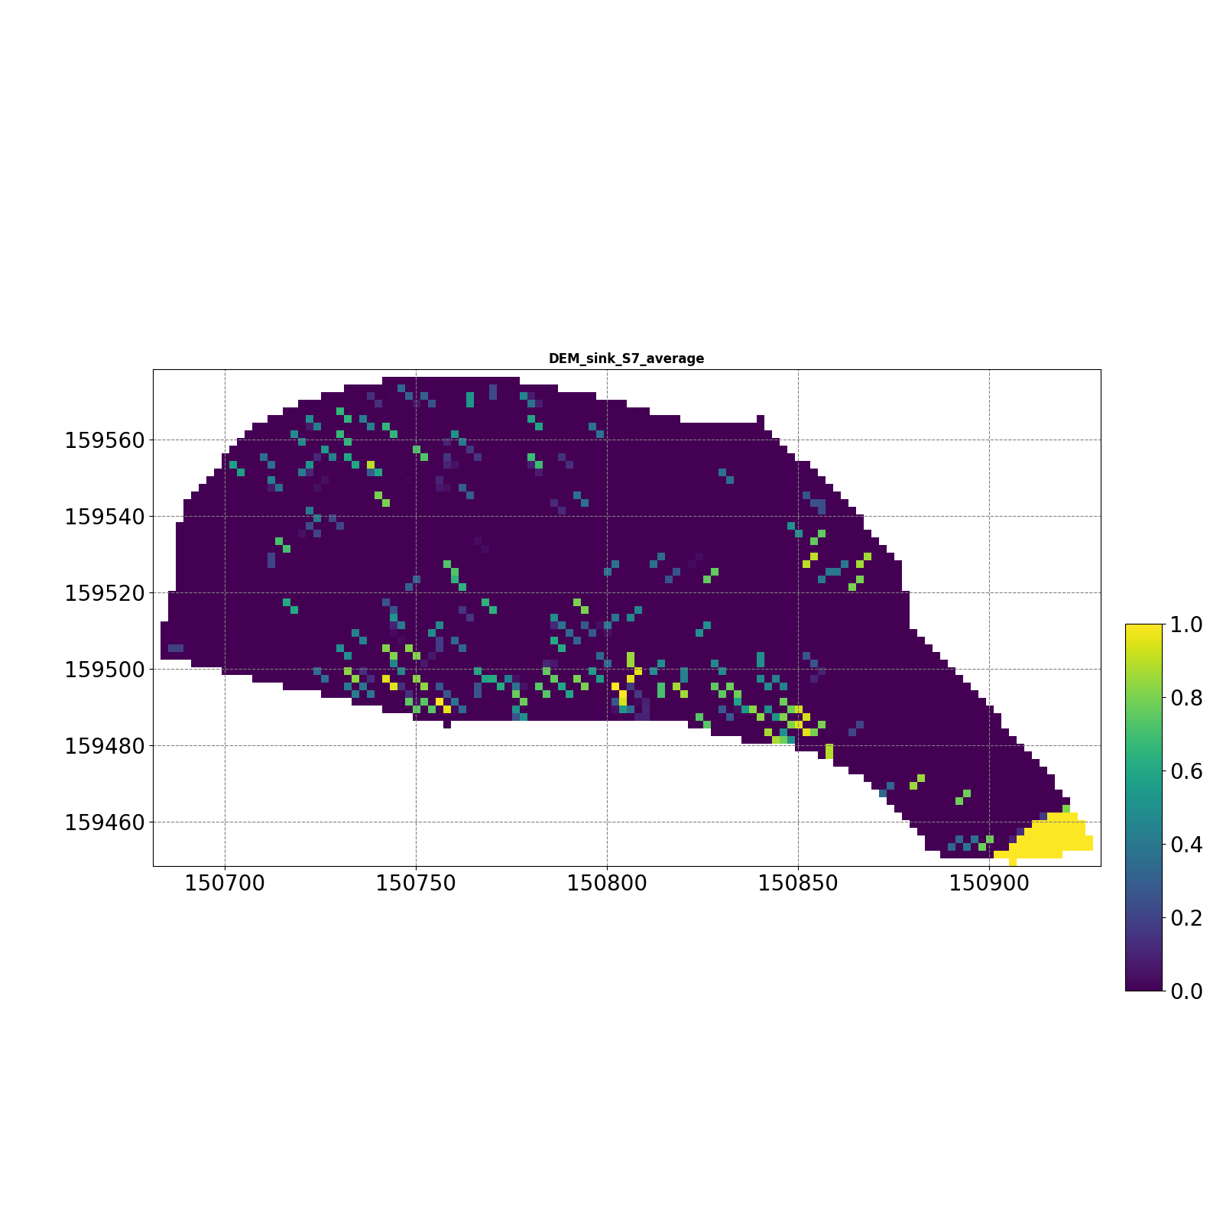
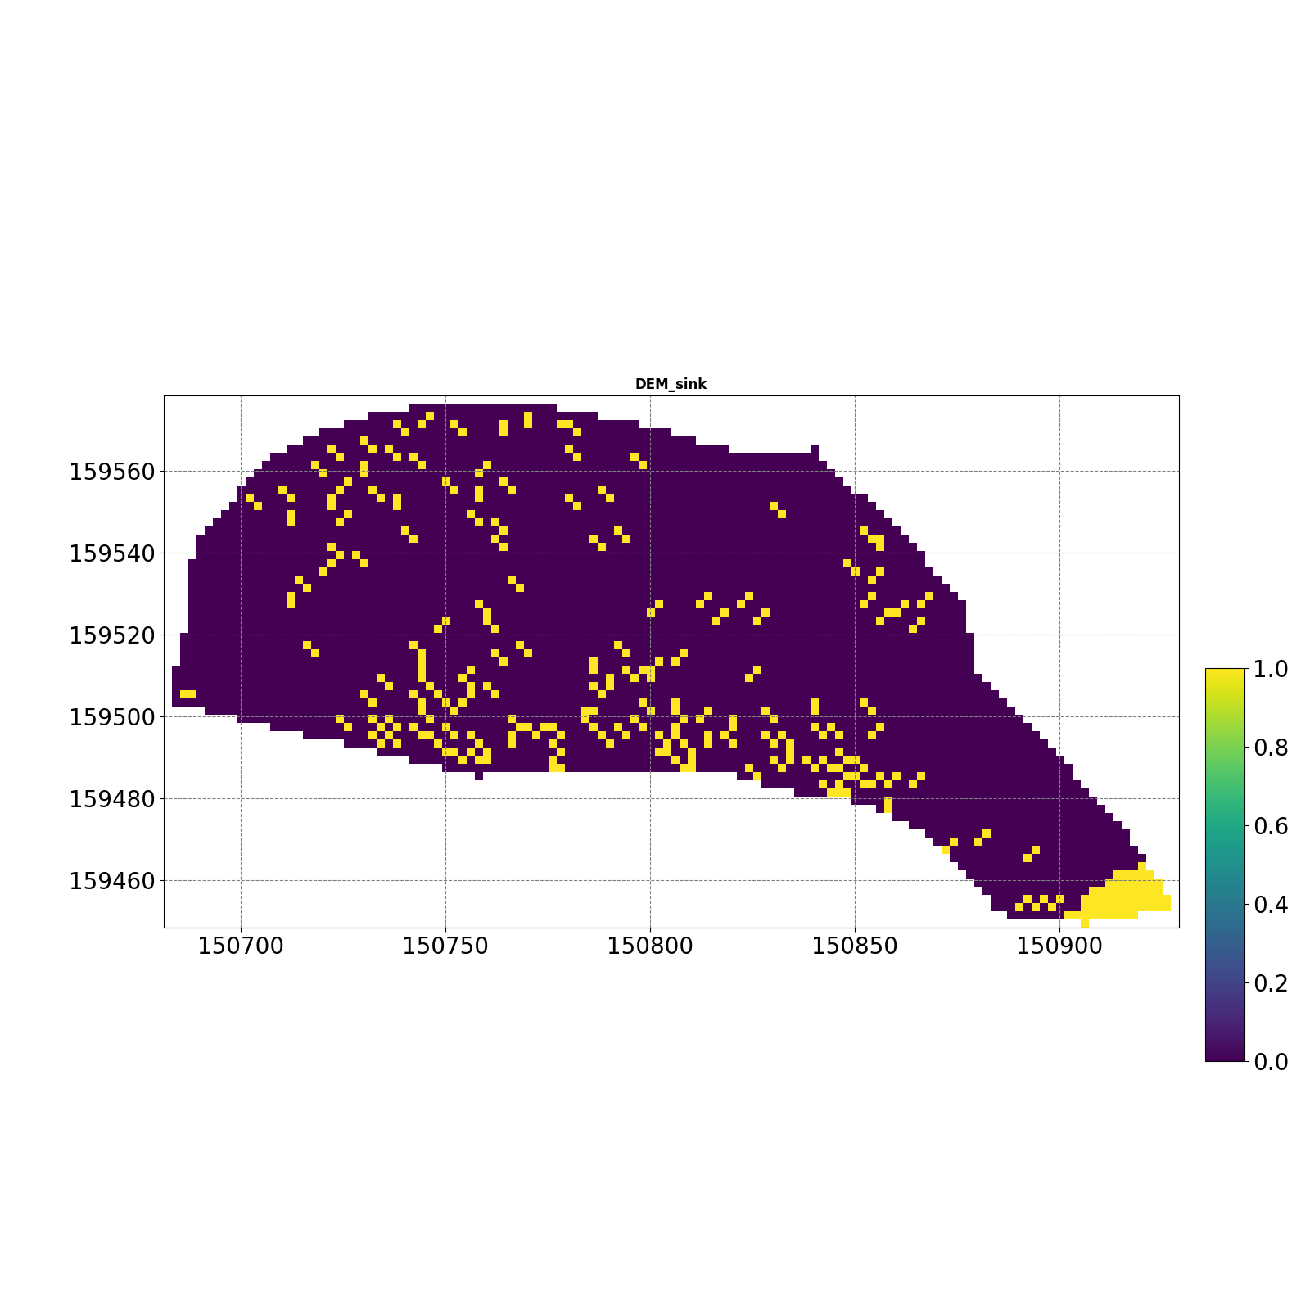
S7

Slide 26
S7-1

Slide 27
S8

Slide 28
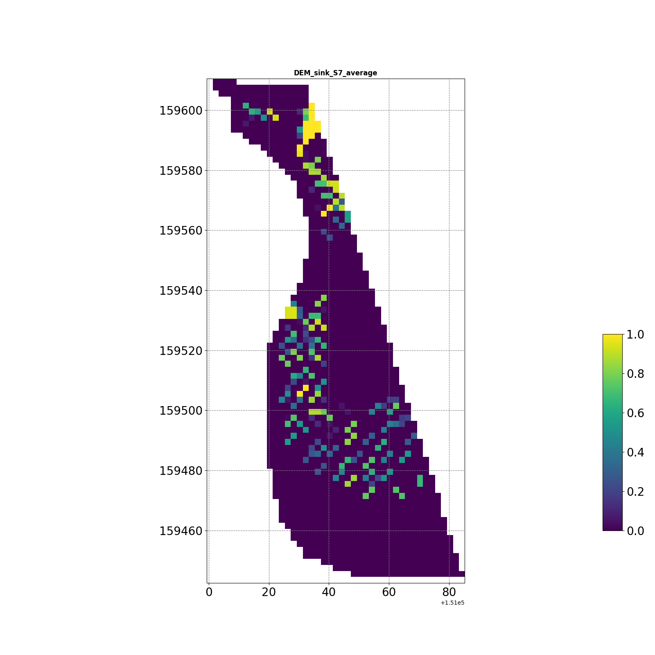
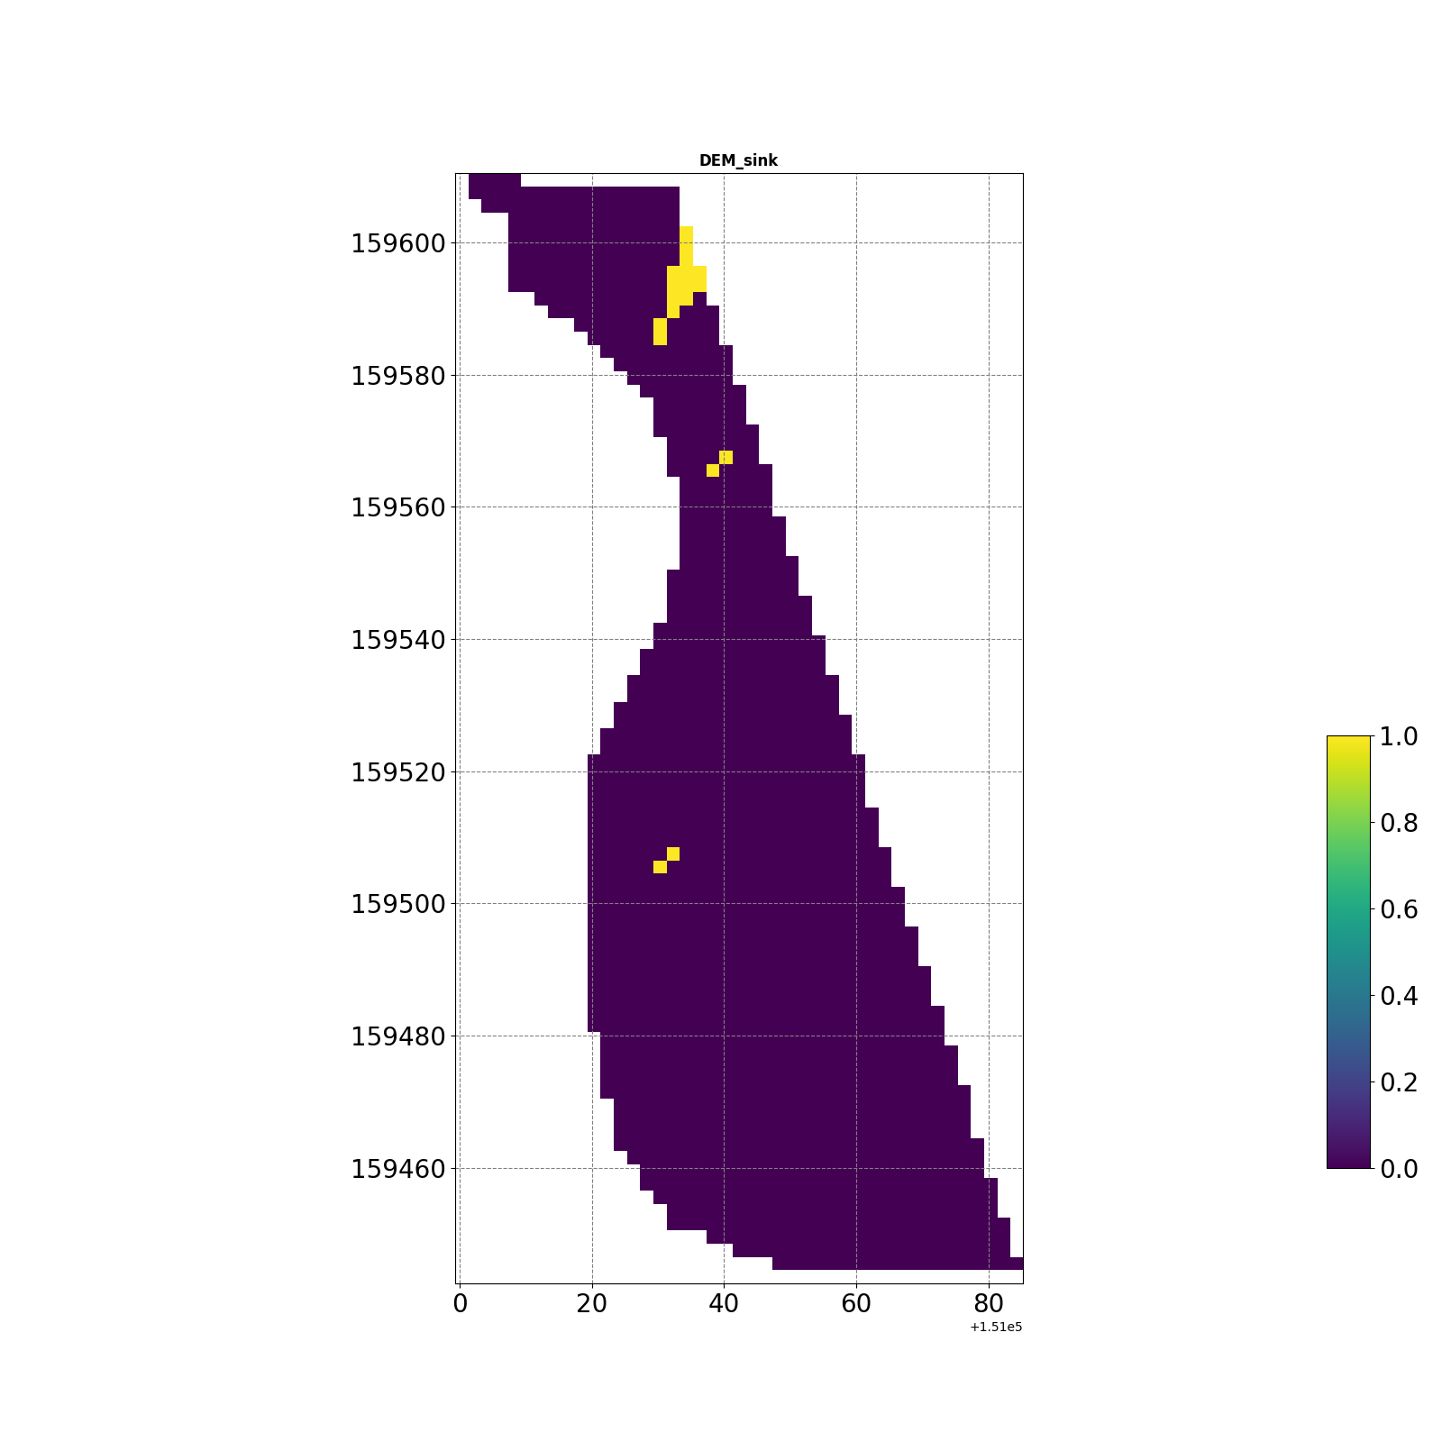
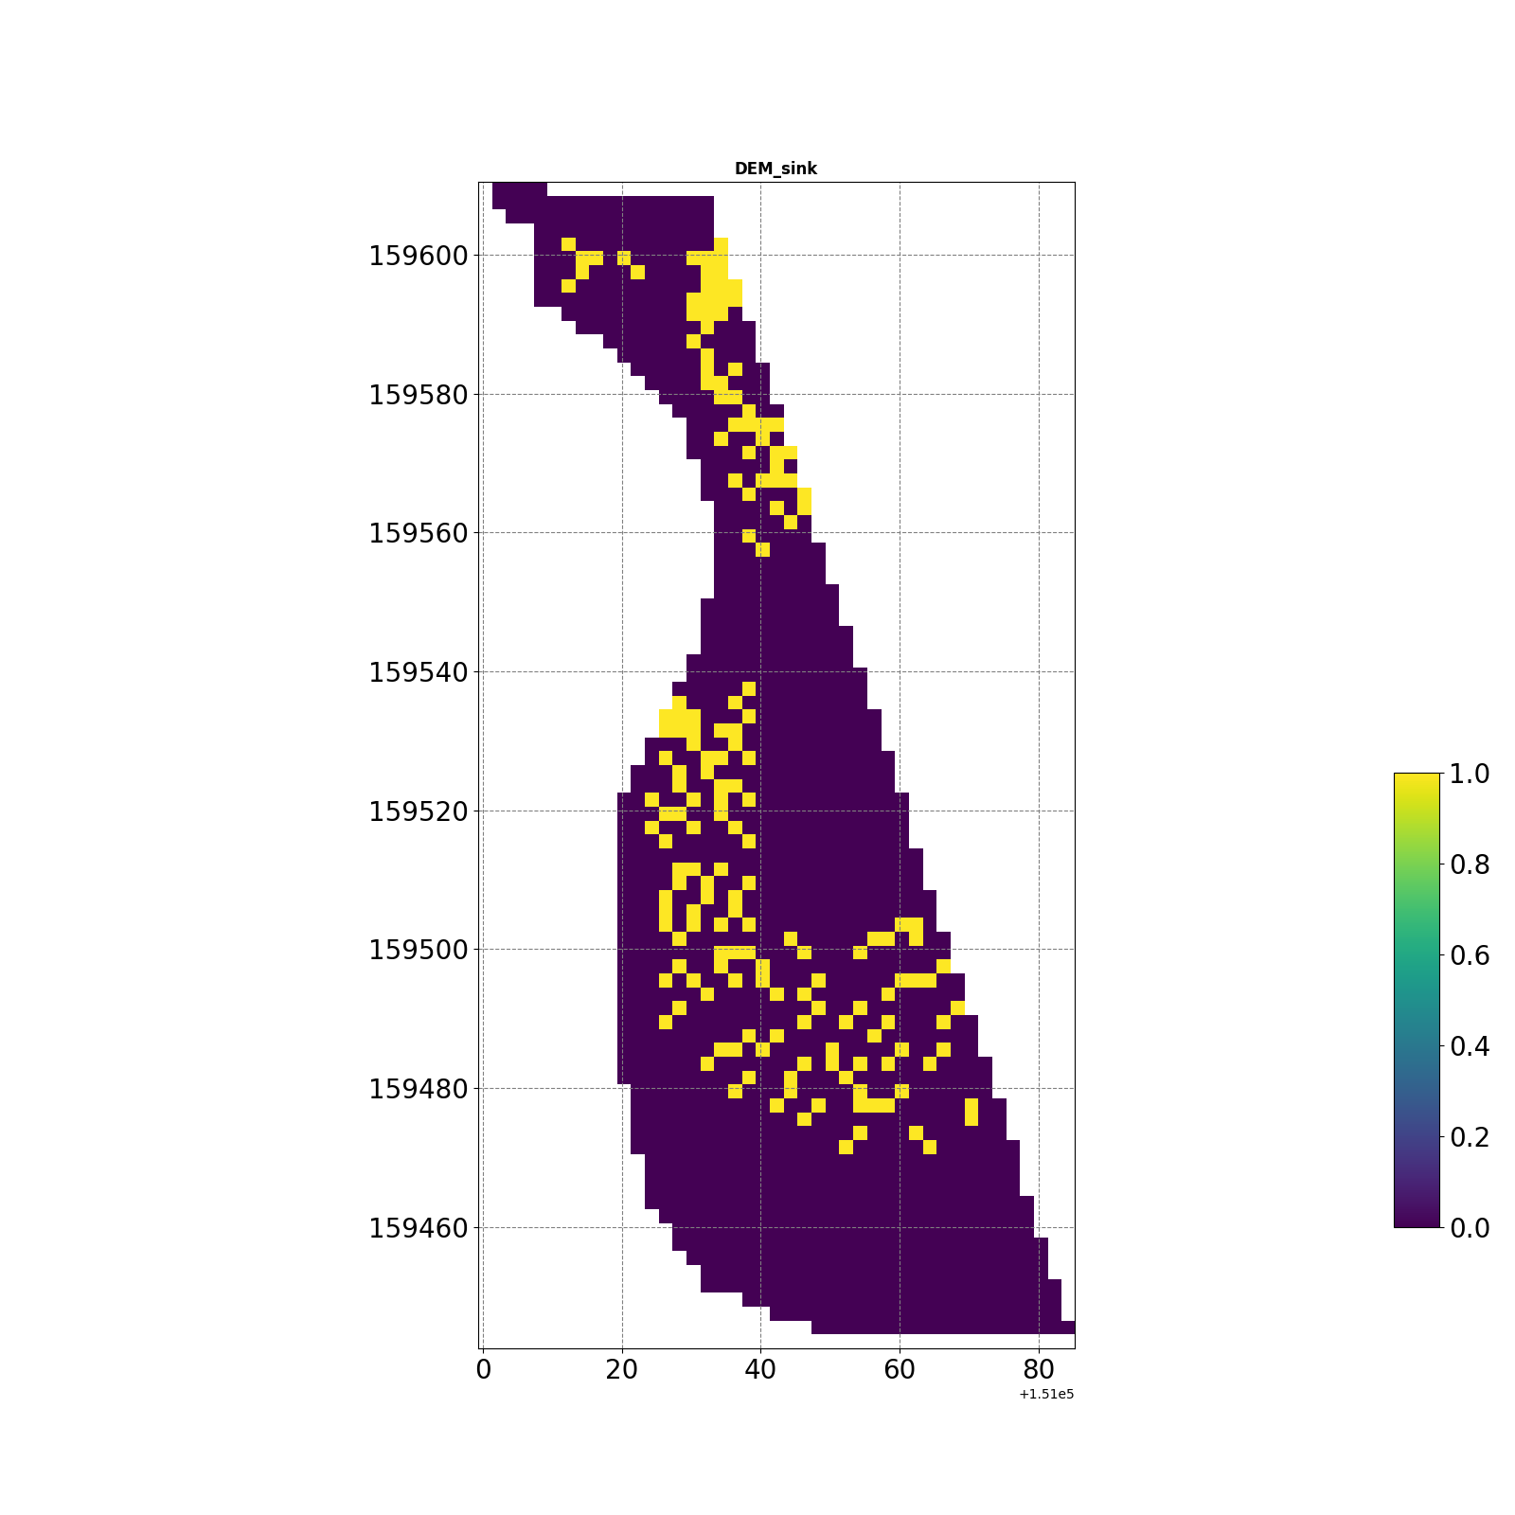
S9

Slide 29
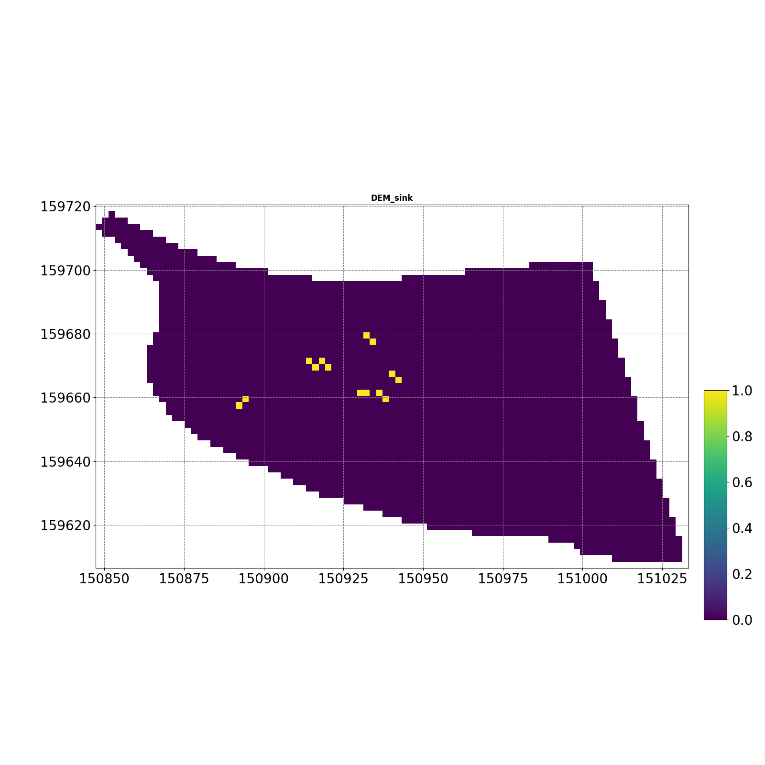


S10

Slide 30
S10-1

Slide 31
S11

Slide 32



S12

Slide 33



S12-1

Slide 34



S12-3

Slide 35



S12-4

Slide 36



S13-1

Slide 37




S14

Slide 38



S14-1

Slide 39
Scenario 02

Slide 40

Lijia Mountain Park, Nanjing, China
Subcatchments: 30
Area: 33.73ha
Rainfall- Chicago design storm IDF
Return period: 2 year (2 hour)
Total volume: 59.71mm

Slide 41

Lijia Mountain Park, Nanjing, China
Subcatchments: 30
Area: 33.73ha
Rainfall- Chicago design storm IDF
Return period: 2 year (2 hour)
Total volume: 59.71mm

Slide 42



